Slide 1

P7/6 Meet the Teacher

Slide 2

BACK!!

Slide 3
Information Powerpoint Agenda
Teacher & Senior Leadership Team Introduction
School Vision
Health & Wellbeing
Behaviour and Positive Relationships
Timetables
Classroom Routines/Expectations
Four Context for Learning
Environmental Changes – Pupil’s Voice (Name of learning areas)
Community Hub – Breakfast Club
Sacramental Preparation/God’s Loving Plan
Primary 7/6 Events this Session
Health Promoting Schools
Home Learning/Sharing the Learning
Communication and Bluesky

Slide 4
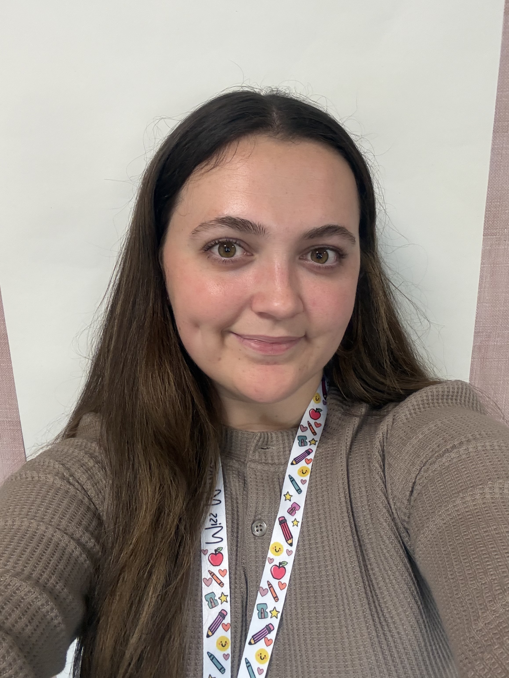
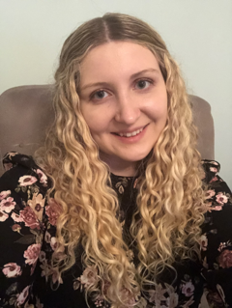
Class Teacher
Miss Morrissey
I am very excited to be teaching P7/6 this year. I am looking forward to building upon the relationships from last year and the exciting times ahead this year.
This year, I will be team-teaching numeracy with Miss Stocks (Primary 7 teacher). Some students from our class will be joining Miss Stocks and some of the other Primary 7 students joining us. By blending our classes for these sessions, students will have the wonderful opportunity to learn and collaborate across year groups.

Slide 5

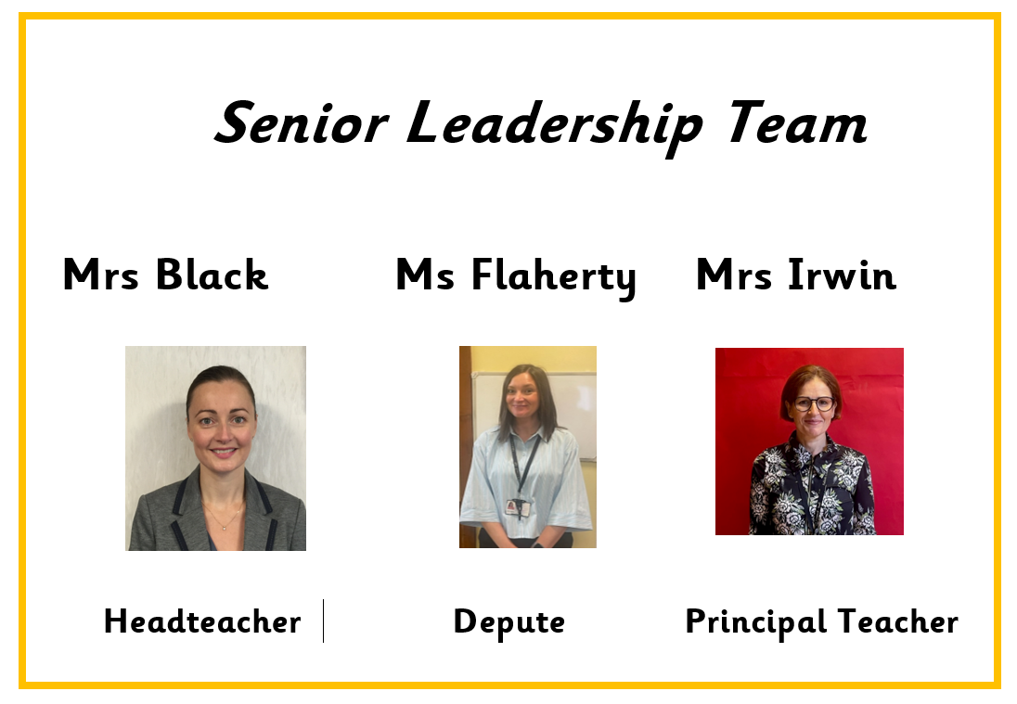

Slide 6
ONE BIG FAMILY, ONE GREAT SCHOOL
Our Vision
St Patrick’s Primary School and Early Learning Centre is a community of faith and a family of learners.
We set high expectations of behaviour and effort, and we work closely with parents, parish and partners to guide and support our children in their educational and spiritual journey – fostering a love of learning and preparing them for the future.
We respect the rights of all members of our community and promote children’s rights from the United Nations Convention on the Rights of the Child (UNCRC) throughout the school.

Slide 7
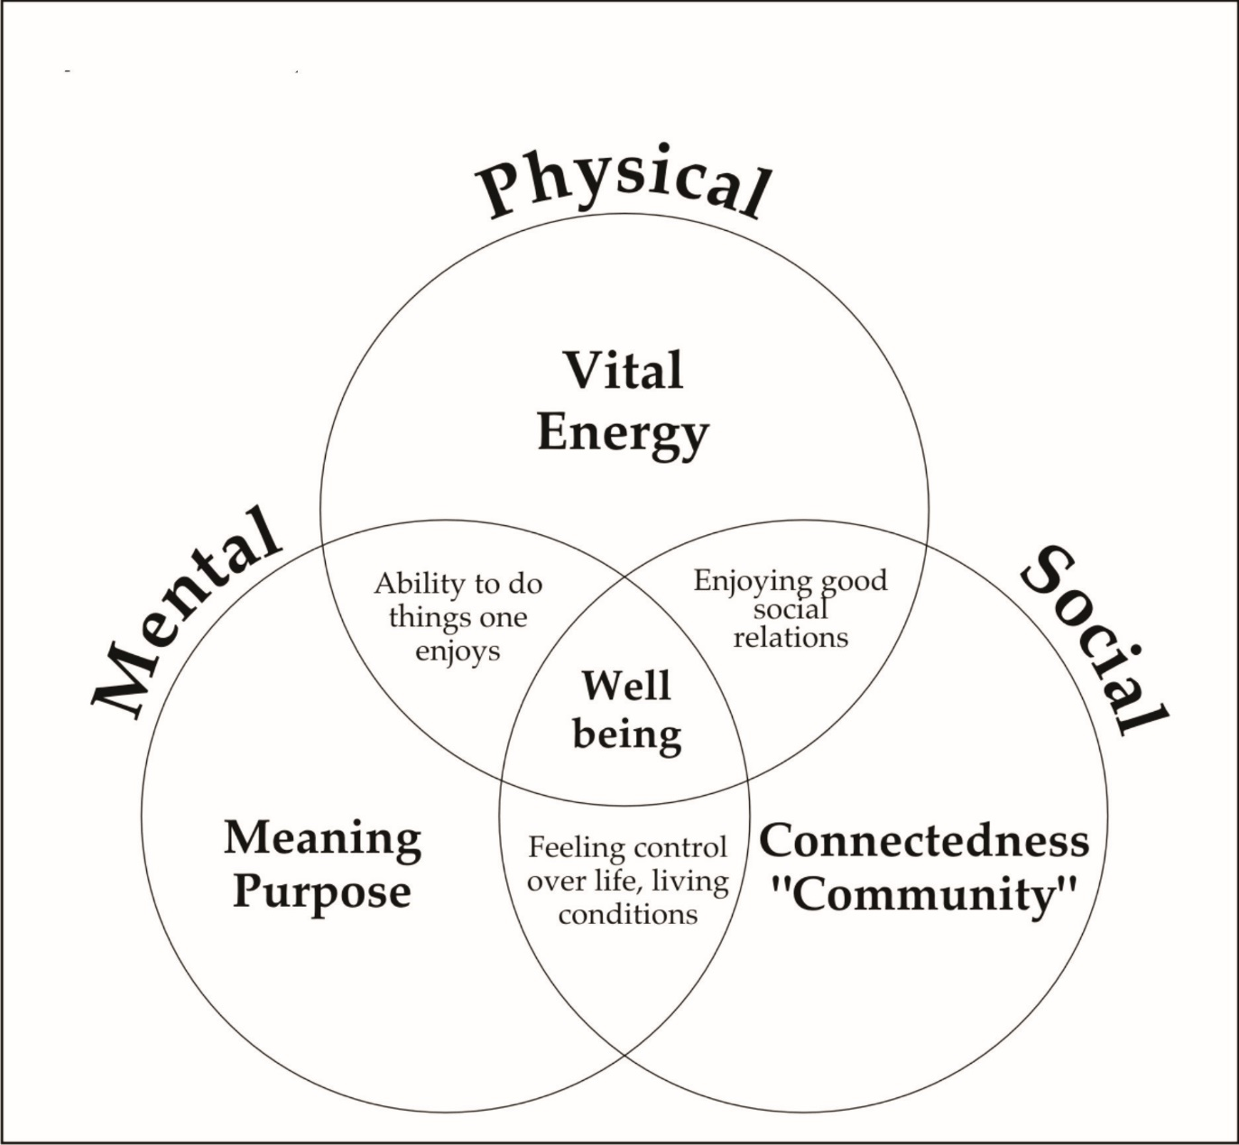
Our pupils' Health and Wellbeing is always in the forefront of our minds.
Our children have impressed us with how they continue to follow the rules and routines in place in school.
Health and Wellbeing of our children is promoted and explored daily, through topics and across the curriculum.
Thank you for your continued support.

Slide 8
Behaviour & Relationships
Early Intervention Policy
Children have had a settling in period at the beginning of this session. If necessary, we will contact you for your support if we have any concerns over your child's behaviour in school.
Positive Relationships Policy
At St. Patrick's, we are a welcoming Catholic community dedicated to nurturing every child's faith, wellbeing, and success through an inclusive, respectful, and supportive environment.
Our staff have collaboratively updated our Positive Relationships Policy to launch our new 'FRESH' Start element—an approach rooted in our Gospel Values, restorative conversations, early parent partnership, and UNCRC Class Charters to ensure every child feels welcomed, loved and supported to make positive choices.
St Patrick’s Promise
All pupils are aware of and regularly use the St Patrick’s Promise to help them to remember the expectations of them in school each day.

Slide 9



Slide 10


Slide 11
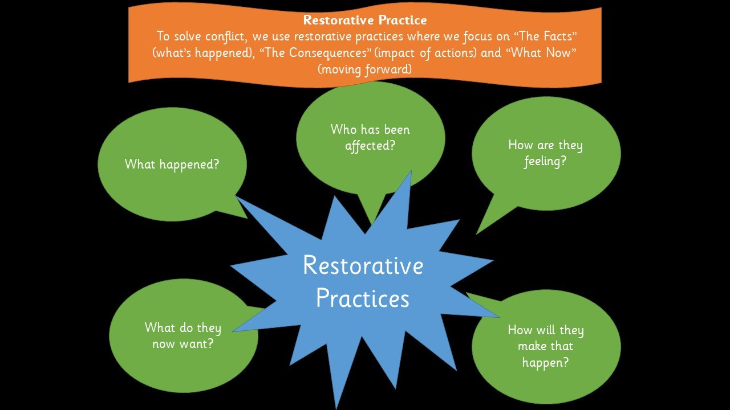

Slide 12
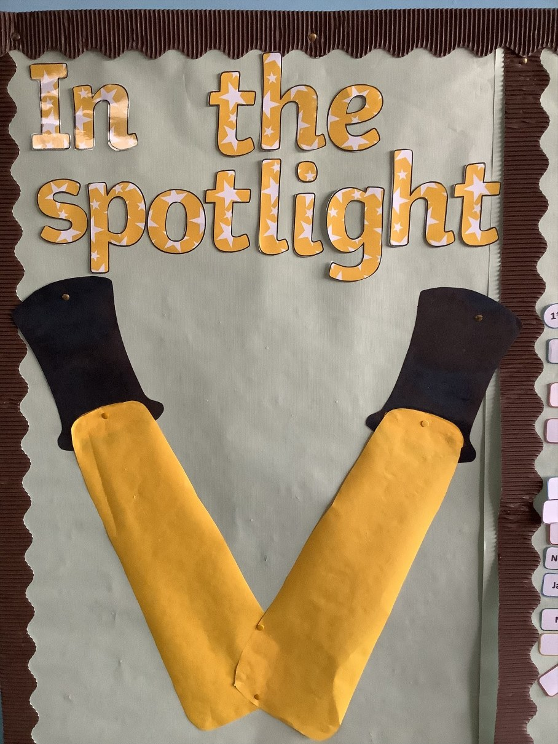
We continue to use a Restorative Practice approach when resolving any conflicts among children.
Positive Behaviour
Positive behaviour is recognised and celebrated throughout each day. Pupils are rewarded for demonstrating positive behaviours such as effort, kindness, respect and for displaying the Gospel Values.
We use our Recognition Boards to highlight the Gospel Values, positive behaviour and focused learning.

Slide 13
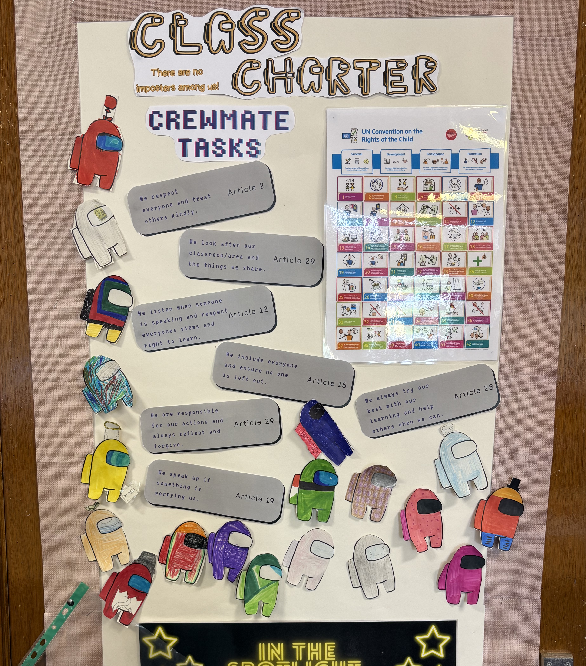
Class Charter

Slide 14

Head teacher awards will be given out on a monthly basis to children who demonstrate a positive attitude to learning and school life.
One child from each class will be nominated for this each month.

Slide 15
Timetable

Slide 16
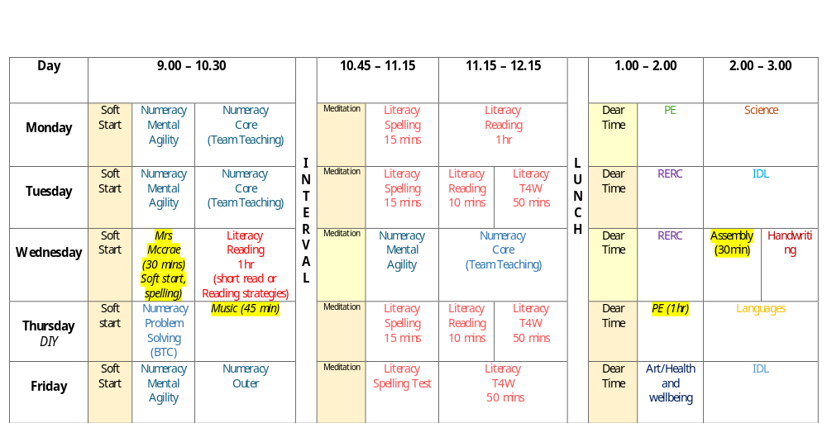

Slide 17
Classroom Routines/Expectations
Daily water for class – filled at home and can be refilled in school
Where possible a change of indoor shoes – especially for winter weather
Full school uniform except on PE days – uniform bank within Community Hub

Slide 18
Mr MacDonald will be taking our class for P.E. on a Thursday and children will participate with the class teacher on a Monday.
On both days where children have P.E. they should come to school dressed in their P.E kit - dark trousers, white top and school jumper/hoodie. P.E may take place outdoors therefore, children should come appropriately dressed for all weathers.
In order to be able to allow pupils to access our playing fields at playtimes could we also ask that children bring an indoor pair of shoes to change into when returning into the building.

Slide 19
Please ensure children adhere to our uniform policy especially during P.E. days.
Plain T-shirt's preferably white, dark bottoms and green jumper.
Outdoor learning will take place throughout the week at anytime reflecting a true interdisciplinary learning approach. Please ensure appropriate clothing is always available as we will be out in all weathers.

Slide 20
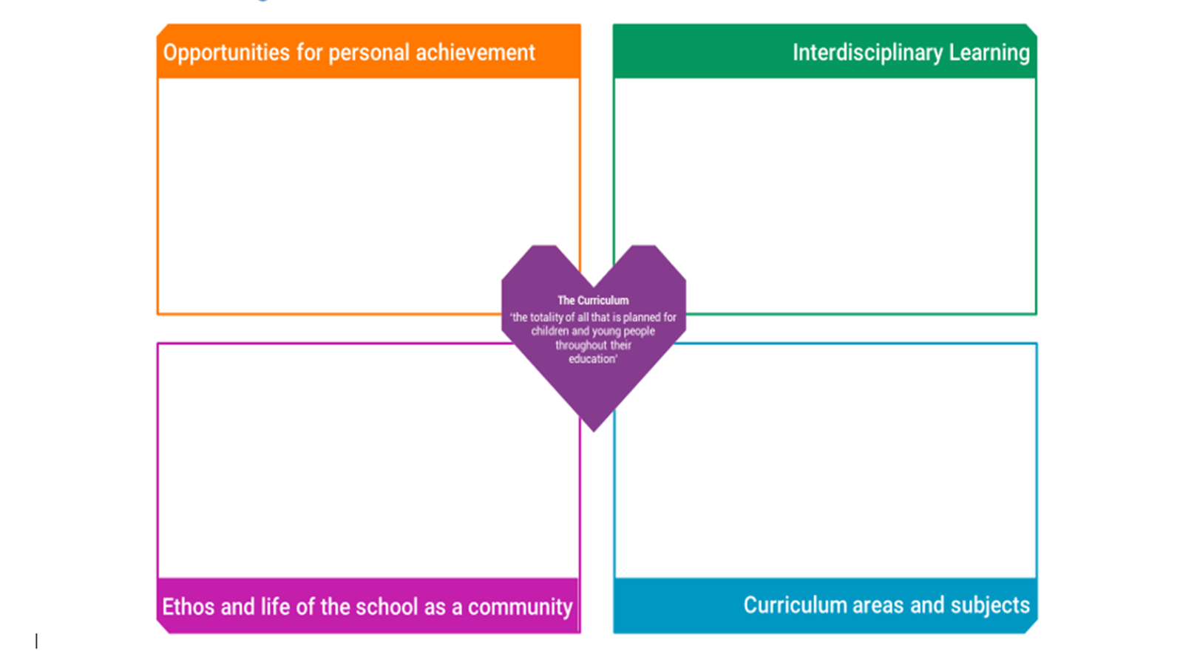

Slide 21
Environmental Changes – Session 2026 27
Our class in located in the old senior area, the area now holds P5-P7 pupils. We will be using this area as an expansion of our classrooms and will be used for work , play and skill-based learning. The area also includes a calm/quiet space and a small library.
In the afternoon, the space will be used for meta-skills/inquiry-based learning and will have themed stations for the children to explore. Each class within the area is timetables for 1 afternoon per week.
We will be seeking pupil ideas to name the 3 learning spaces.

Slide 22

Community Hub – Breakfast Club
We are delighted to be partnering with the ‘Magic Breakfast’ to ensure every primary school student starts the day with a breakfast, boosting concentration, energy, and readiness to learn. This initiative creates a supportive foundation that improves overall attendance and helps all children reach their full academic potential. We welcome any child to access the bagel station for a grab and go breakfast snack on route to their class in the morning. In addition, cereals will be available as well as fruit baskets in every class – available to all.
We are almost ready to launch our Breakfast Club so look out for more information via email soon.

Slide 23
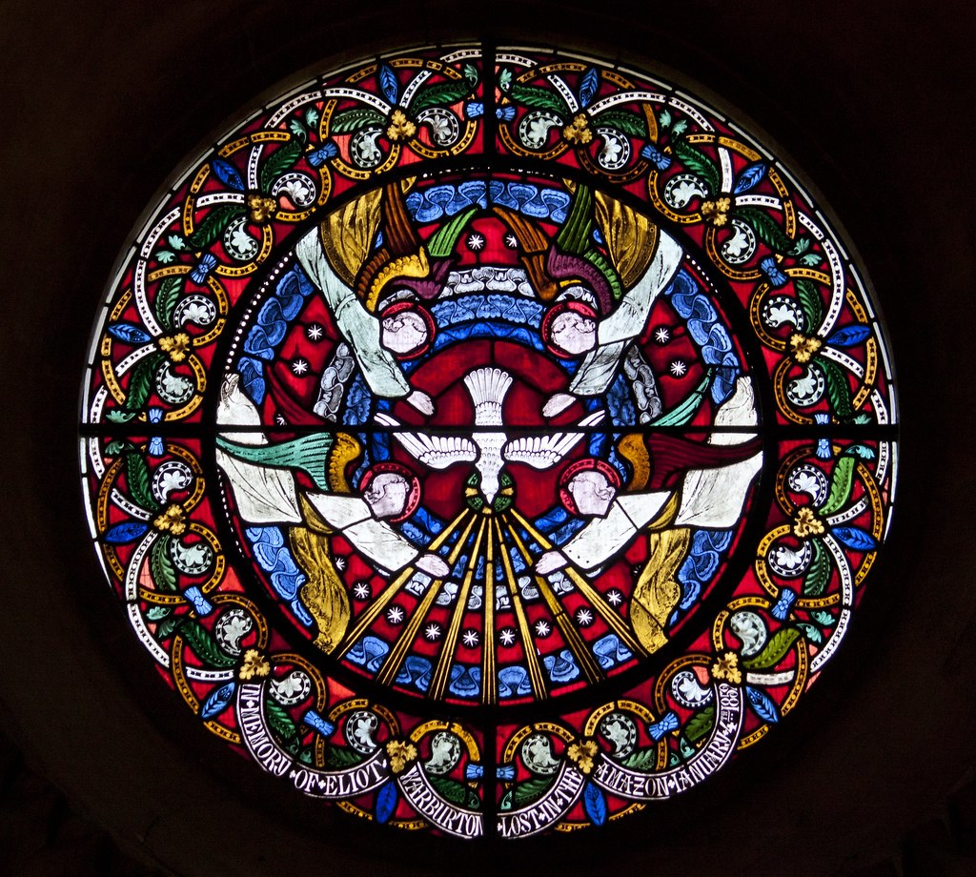

Slide 24
Sacramental Preparation/GLP
P7 Sacramental preparation for Sacrament of Confirmation will begin in the New Year.
Preparation for this sacrament will involve input and support through discussion and home learning activities, these will be shared as we begin our Sacramental journey in class.
The children will also be receiving input in June 2027 following the Gods Loving plan program.

Slide 25
Primary 7/6 Events

Slide 26
P7
Visit to St Modan’s (5/11, 12/11, 19/11)
Confirmation 3rd June
Residential 4th May
Prom
Bikeability
Leaver’s Mass and Lunch
Award ceremony
Transition to St Modan’s (24th & 25th May)
P6
Visit to St Modan’s (5/11, 12/11, 19/11)
iPad allocation
Athletics*

Slide 27

Silver Reading Schools Accreditation Awarded June 2026
We have been on our Reading Schools journey in recent years and were delighted to receive this accreditation in recognition for the hard work that has gone in to building and sustaining a reading culture across our whole school community.
Next steps will be to continue this journey as we aim for our Gold Reading Schools Accreditation.
Thank you for your continued support!

Slide 28



Reading Eggs Programme
We have access to the Digital Reading Eggs Programme within our Primary 2, 3, 4 and Primary 6 and 7 stages for class and home use.
This is a progressive programme that supports and challenges pupils at their own level.
It has a focus on Reading’s five pillars of literacy:
phonemic awareness
phonics
vocabulary
fluency
Comprehension
Reading Eggs Programme:
Fast Phonics
Reading Eggs
Reading Eggspress

Slide 29

Reading Home Learning
Following a trial within our Infant Department and considering pupil, parent and staff feedback we will soon be moving forward with a new online reading resource Oxford Reading Buddy. This can be used in class and at home to support, challenge and extend our teaching and learning of reading.
Provides a personalised E-Book Library that pupils can access at their reading level. This will be set by Class Teachers and monitored as they progress.
We have close links with Denny Library and would encourage pupils and parents to use this wonderful resource to explore and support them on their reading journey.

Slide 30

Health Promoting Schools
Healthy Snacks Please encourage your child to bring a healthy snack to school. Please be aware we are a nut free and in addition, our lunch hall is egg free . We kindly ask that all families adhere to this when selecting your child’s snack/packed lunch.
As snack time is very brief, please provide your child with only 1 item.
Water Bottles
Your child will be able to access water throughout the day from their water bottles. Please provide water each morning and bottles can be refilled at various times throughout day.
Juice may be brought for snack/lunchtime only.

Slide 31
As the number of children and staff who have moderate to severe nut allergies are increasing can we as our families to please be mindful of the food items sent to school - some snacks do not obviously contain nuts or traces of nuts such as Kinder Bueno or hippo bars.
We are now also egg free. (egg in items like cake etc. are acceptable)

Slide 32
Communication
School email address – stpatricksprimaryschool@education.falkirk.sch.uk
School main office phone number – 01324 508840
Website - https://www.st-patricks.falkirk.sch.uk/
Our Parent Communication Policy is available on our website
If you feel your family requires a greater level of support in order to improve your child(rens) attendance please contact the school on 01324 508840 / stpartricksprimaryschool@education.Falkirk.sch.uk and Ms Flaherty will get back to you as soon as possible.

Slide 33

Follow your child's class on Bluesky - our school social media platform.
@missm-stp.bsky.social

