Slide 1


Miss Bell
P4 Meet The Teacher

Slide 2

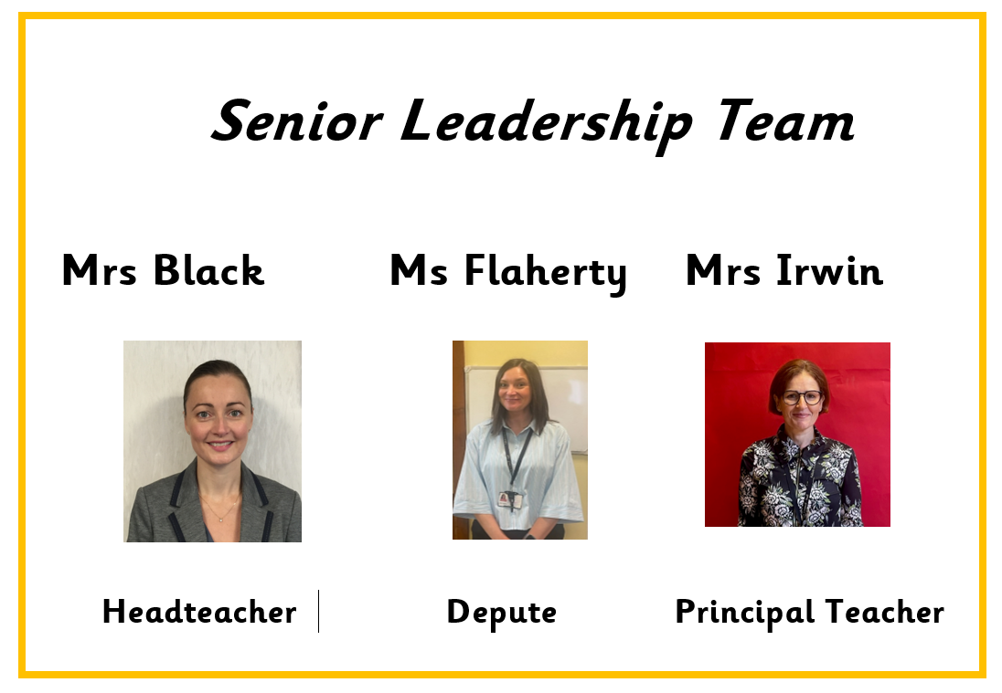

Slide 3
ONE BIG FAMILY, ONE GREAT SCHOOL
Our Vision
St Patrick’s Primary School and Early Learning Centre is a community of faith and a family of learners.
We set high expectations of behaviour and effort, and we work closely with parents, parish and partners to guide and support our children in their educational and spiritual journey – fostering a love of learning and preparing them for the future.
We respect the rights of all members of our community and promote children’s rights from the United Nations Convention on the Rights of the Child (UNCRC) throughout the school.

Slide 4
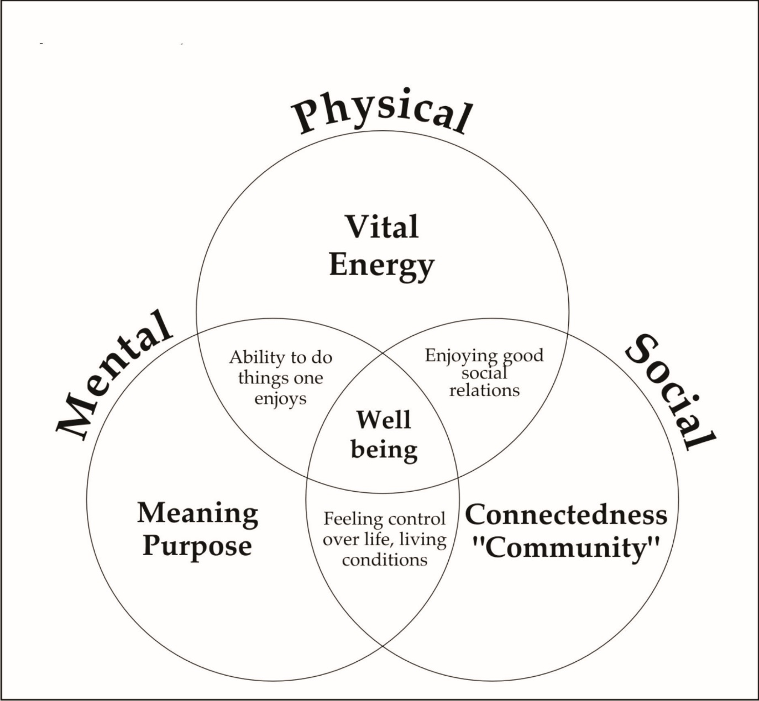
Our pupils' Health and Wellbeing is always in the forefront of our minds.
Our children have impressed us with how they continue to follow the rules and routines in place in school.
Health and Wellbeing of our children is promoted and explored daily, through topics and across the curriculum.
Thank you for your continued support.

Slide 5
Behaviour & Relationships
Early Intervention Policy
Children have had a settling in period at the beginning of this session. If necessary, we will contact you for your support if we have any concerns over your child's behaviour in school.
Positive Relationships Policy
At St. Patrick's, we are a welcoming Catholic community dedicated to nurturing every child's faith, wellbeing, and success through an inclusive, respectful, and supportive environment.
Our staff have collaboratively updated our Positive Relationships Policy to launch our new 'FRESH' Start element—an approach rooted in our Gospel Values, restorative conversations, early parent partnership, and UNCRC Class Charters to ensure every child feels welcomed, loved and supported to make positive choices.
St Patrick’s Promise
All pupils are aware of and regularly use the St Patrick’s Promise to help them to remember the expectations of them in school each day.

Slide 6



Slide 7

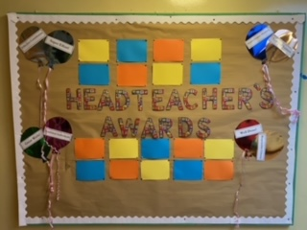
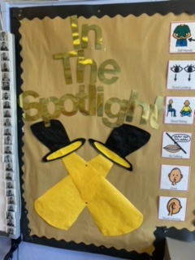

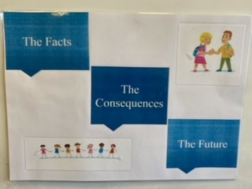
Behaviour
Notes:
Our pupils health and well being is always in the forefront of minds.
St Patrick’s is a place where all are welcomed, loved, forgiven and encouraged to live out our Gospel Values. Our St Patrick’s Promise was created by our pupils and helps us to demonstrate respect, kindness and a positive attitude.
We also recognise and celebrate positive behaviour in a variety of ways including Star of the Week, Recognition Boards (“In the Spotlight”), Monthly Head Teacher’s Certificates and Restorative Practice.
We appreciate your continued support in encouraging children to follow our St Patrick’s Promise .
Head teacher awards will be given out on a monthly basis to children who demonstrate a positive attitude to learning and school life.
One child from each class will be nominated for this each month.

Slide 8
We continue to use a Restorative Practice approach when resolving any conflicts among children.
Positive Behaviour
Positive behaviour is recognised and celebrated throughout each day. Pupils are rewarded for demonstrating positive behaviours such as effort, kindness, respect and for displaying the Gospel Values.
We use our Recognition Boards to highlight the Gospel Values, positive behaviour and focused learning.

Slide 9


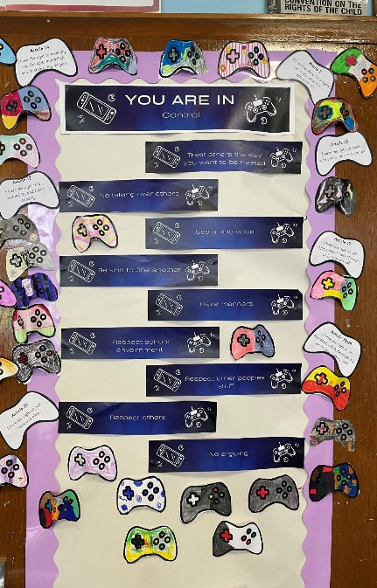


Class Charter

Slide 11

Community Hub – Breakfast Club
Coming Soon!
Notes:
We are delighted to be partnering with the ‘Magic Breakfast’ to ensure every primary school student starts the day with a breakfast, boosting concentration, energy, and readiness to learn. This initiative creates a supportive foundation that improves overall attendance and helps all children reach their full academic potential. We welcome any child to access the bagel station for a grab and go breakfast snack on route to their class in the morning. In addition, cereals will be available as well as fruit baskets in every class – available to all.
We are almost ready to launch our Breakfast Club so look out for more information via email soon.

Slide 12
Classroom Routines/Expectations
Daily water for class – filled at home and can be refilled in school
Where possible a change of indoor shoes – especially for winter weather
Full school uniform except on PE days – uniform bank within Community Hub

Slide 13
Mr MacDonald will be taking our class for P.E. on a Thursday and children will participate with the class teacher on a Monday.
On both days where children have P.E. they should come to school dressed in their P.E kit - dark trousers, white top and school jumper/hoodie. P.E may take place outdoors therefore, children should come appropriately dressed for all weathers.
In order to be able to allow pupils to access our playing fields at playtimes could we also ask that children bring an indoor pair of shoes to change into when returning into the building.

Slide 14
Please ensure children adhere to our uniform policy especially during P.E. days.
Plain T-shirt's preferably white, dark bottoms and green jumper.
Outdoor learning will take place throughout the week at anytime reflecting a true interdisciplinary learning approach. Please ensure appropriate clothing is always available as we will be out in all weathers.

Slide 15
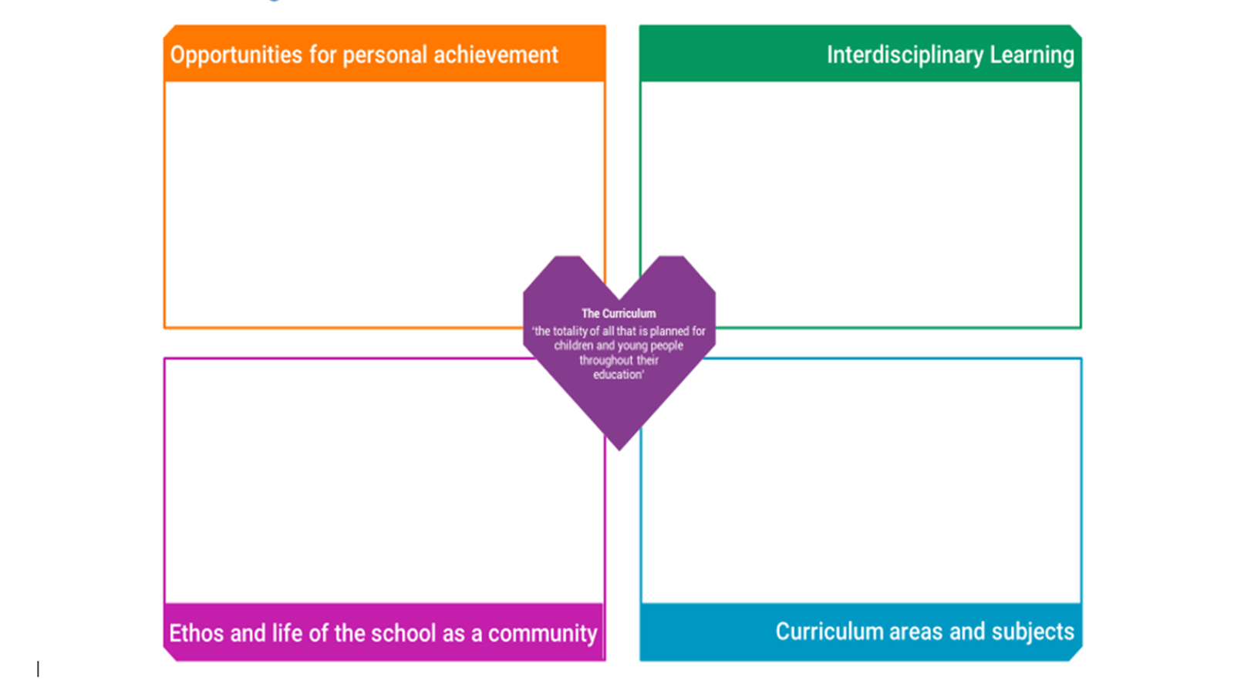
Notes:
A curriculum is all the learning and experiences planned for learners from their earliest years, through school and beyond. In Curriculum for Excellence, this learning can be planned for and experienced by learners across the four contexts for learning. The four contexts for learning in CfE allow schools flexibility to plan a curriculum that suits their context and setting.
Home School Links- Learners need opportunities to achieve in the classroom and beyond. This gives them a sense of satisfaction and builds confidence, motivation and resilience. All schools should plan to offer opportunities for achievement and to provide the support and encouragement which will enable learners to step forward and undertake new challenges. Schools should work closely with other organisations to help learners find information and opportunities to help them achieve. Please share wider achievements with us so we can acknowledge them in school also.

Slide 16
Environmental Changes – Session 2026 27
We have a community classroom.
We will be seeking pupil ideas to name the 3 learning spaces.
P4 cloakroom in in middle of school.

Slide 17
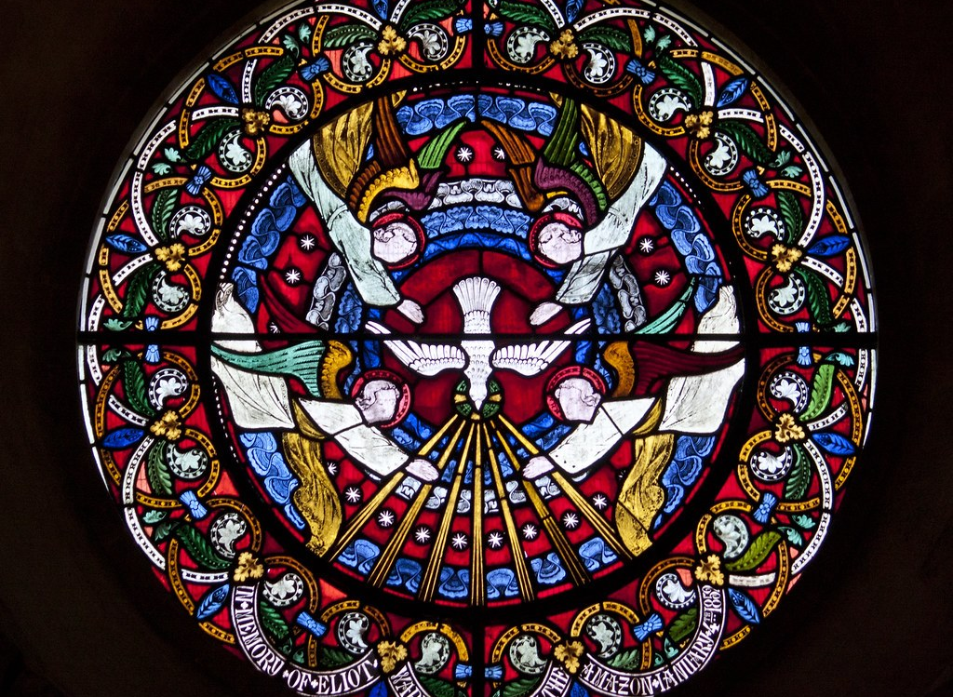
GLP: This combines health and RE education, specifically focusing on relationships.
Taught from P1-P7 at appropriate level.
P4 tasks completed in class in the final term.
P4 Sacramental preparation for Sacrament of Confirmation will begin in the New Year.
Preparation for this sacrament will involve input and support through discussion and home learning activities, these will be shared as we begin our Sacramental journey in class.

Slide 18
Timetable

Slide 19
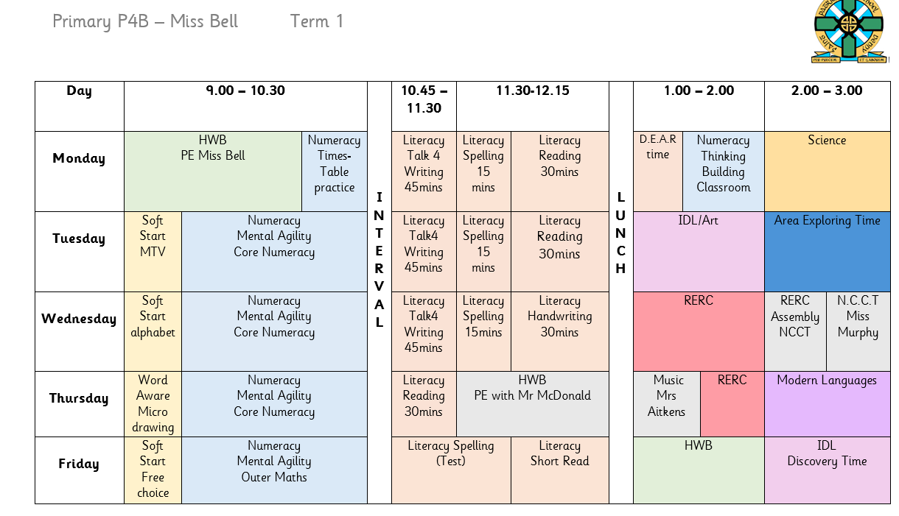

Slide 20
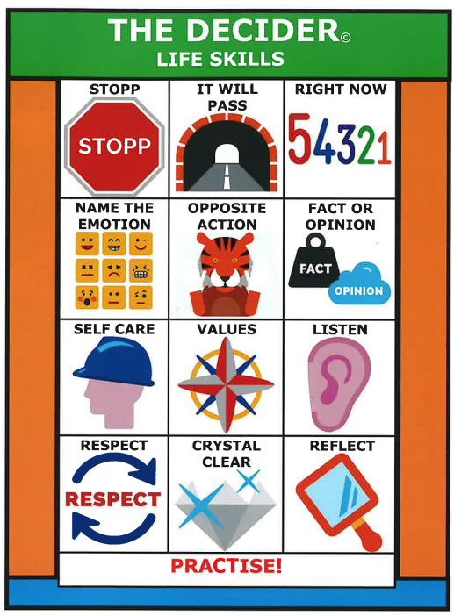

Term 1 in Primary 4
Class Charter – UNCRC Rights
Team building and Team work – relationships
HWB – SHANARRI – Monsters inc/university

Slide 21
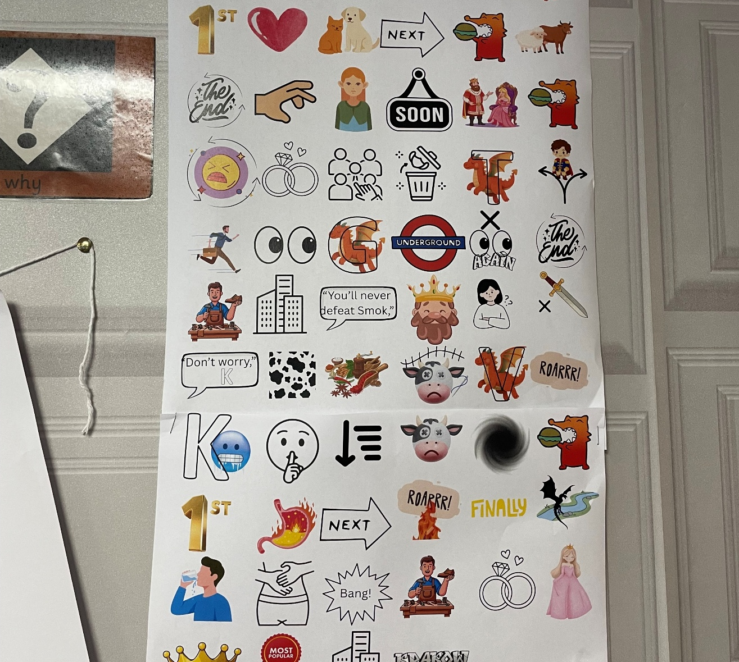
Talk 4 Writing
The Cobbler and the Dragon.
Story map.

Slide 22
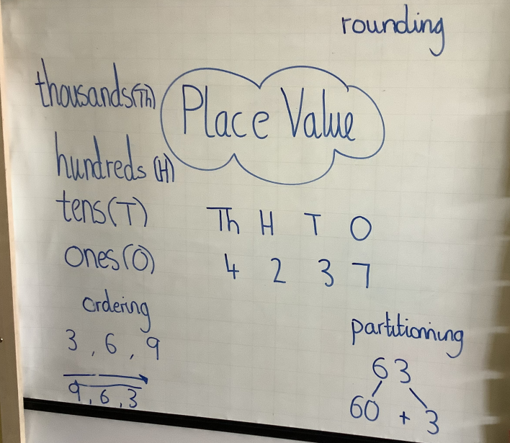
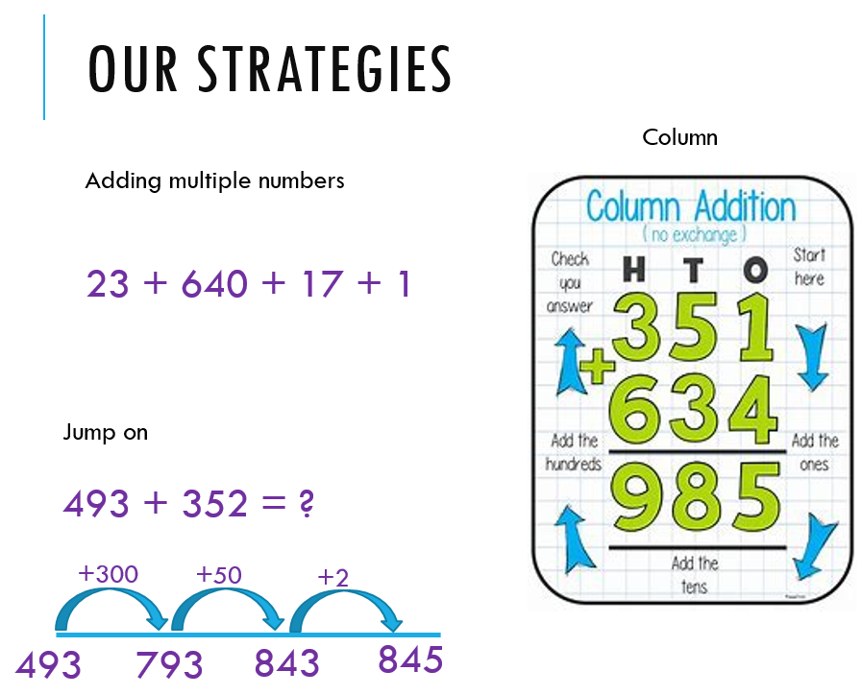
Numeracy in Term 1
Place Value
Addition

Slide 23


Building Thinking Classroom
What is a Building Thinking Classroom? A Building Thinking Classroom is an approach to learning that encourages children to think, talk, problem-solve, and work together rather than simply being shown how to complete a task. In a Building Thinking Classroom, children: Work collaboratively with classmates. Discuss and share ideas. Explore different ways to solve problems. Learn from mistakes and try new strategies. Develop confidence in explaining their thinking. Build resilience when faced with challenges. Why do we use it? Research shows that children learn more deeply when they actively engage with their learning. Rather than focusing only on getting the correct answer, children learn how to think critically, communicate their ideas, and work effectively with others.

Slide 24

Reading
St Patrick’s P.S.

Slide 25

Silver Reading Schools Accreditation Awarded June 2026
We have been on our Reading Schools journey in recent years and were delighted to receive this accreditation in recognition for the hard work that has gone in to building and sustaining a reading culture across our whole school community.
Next steps will be to continue this journey as we aim for our Gold Reading Schools Accreditation.
Thank you for your continued support!

Slide 26

Reading Resources
We have a wealth of resources to support our teaching and learning of reading in St Patrick’s across the levels. These come in physical and digital formats.
Physical Texts:
A wide range of Oxford Reading Tree resources
Oxford Reading Tree Classics
Treetops- Reflect Fiction and Non-Fiction
Chucklers
Greatest Stories
Project X Code
School and Class Library Books

Slide 27



Reading Eggs Programme
We have access to the Digital Reading Eggs Programme within our Primary 2, 3, 4 and Primary 6 and 7 stages for class and home use.
Reading Eggs Programme:
Fast Phonics
Reading Eggs
Reading Eggspress

Slide 28



Reading Eggs Programme
Is a progressive programme that supports and challenges pupils at their own level.
Science of Reading’s five pillars of literacy
phonemic awareness
phonics
vocabulary
fluency
Comprehension

Slide 29

Reading Home Learning
Following a trial within our Infant Department and considering pupil, parent and staff feedback we will soon be moving forward with a new online reading resource Oxford Reading Buddy. This can be used in class and at home to support, challenge and extend our teaching and learning of reading.
Provides a personalised E-Book Library that pupils can access at their reading level. This will be set by Class Teachers and monitored as they progress.
We have close links with Denny Library and would encourage pupils and parents to use this wonderful resource to explore and support them on their reading journey.

Slide 30

Health Promoting Schools
Healthy Snacks Please encourage your child to bring a healthy snack to school. Please be aware we are a nut free and in addition, our lunch hall is egg free . We kindly ask that all families adhere to this when selecting your child’s snack/packed lunch.
As snack time is very brief, please provide your child with only 1 item.
Water Bottles
Your child will be able to access water throughout the day from their water bottles. Please provide water each morning and bottles can be refilled at various times throughout day.
Juice may be brought for snack/lunchtime only.

Slide 31
As the number of children and staff who have moderate to severe nut allergies are increasing can we as our families to please be mindful of the food items sent to school - some snacks do not obviously contain nuts or traces of nuts such as Kinder Bueno or hippo bars.

Slide 32
Communication
School email address – stpatricksprimaryschool@education.falkirk.sch.uk
School main office phone number – 01324 508840
Website - https://www.st-patricks.falkirk.sch.uk/
Our Parent Communication Policy is available on our website
If you feel your family requires a greater level of support in order to improve your child(rens) attendance please contact the school on 01324 508840 / stpartricksprimaryschool@education.Falkirk.sch.uk and Ms Flaherty will get back to you as soon as possible.

Slide 33

Follow your child's class on Bluesky
@missbell-stp.bsky.social

