Slide 1

Primary 3
Meet the Teacher

Slide 2






Mrs McConnell

Slide 3
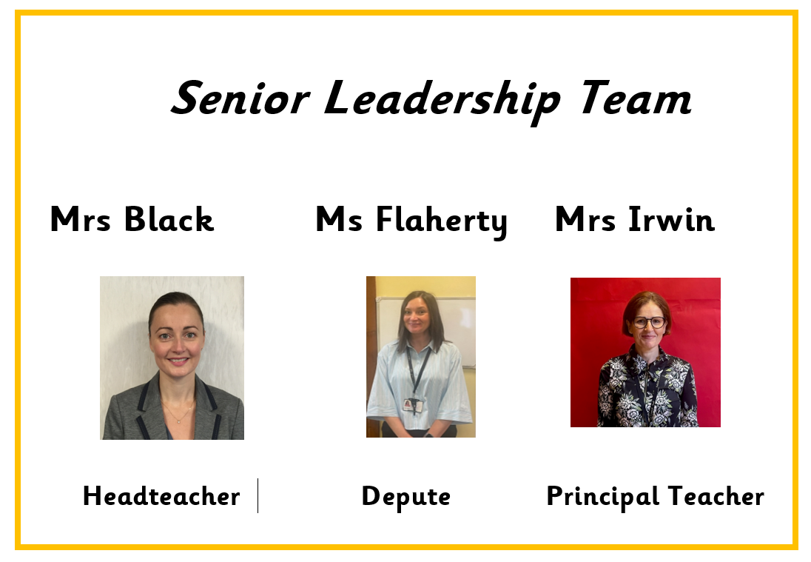

Slide 4
ONE BIG FAMILY, ONE GREAT SCHOOL
Our Vision
St Patrick’s Primary School and Early Learning Centre is a community of faith and a family of learners.
We set high expectations of behaviour and effort, and we work closely with parents, parish and partners to guide and support our children in their educational and spiritual journey – fostering a love of learning and preparing them for the future.
We respect the rights of all members of our community and promote children’s rights from the United Nations Convention on the Rights of the Child (UNCRC) throughout the school.

Slide 5
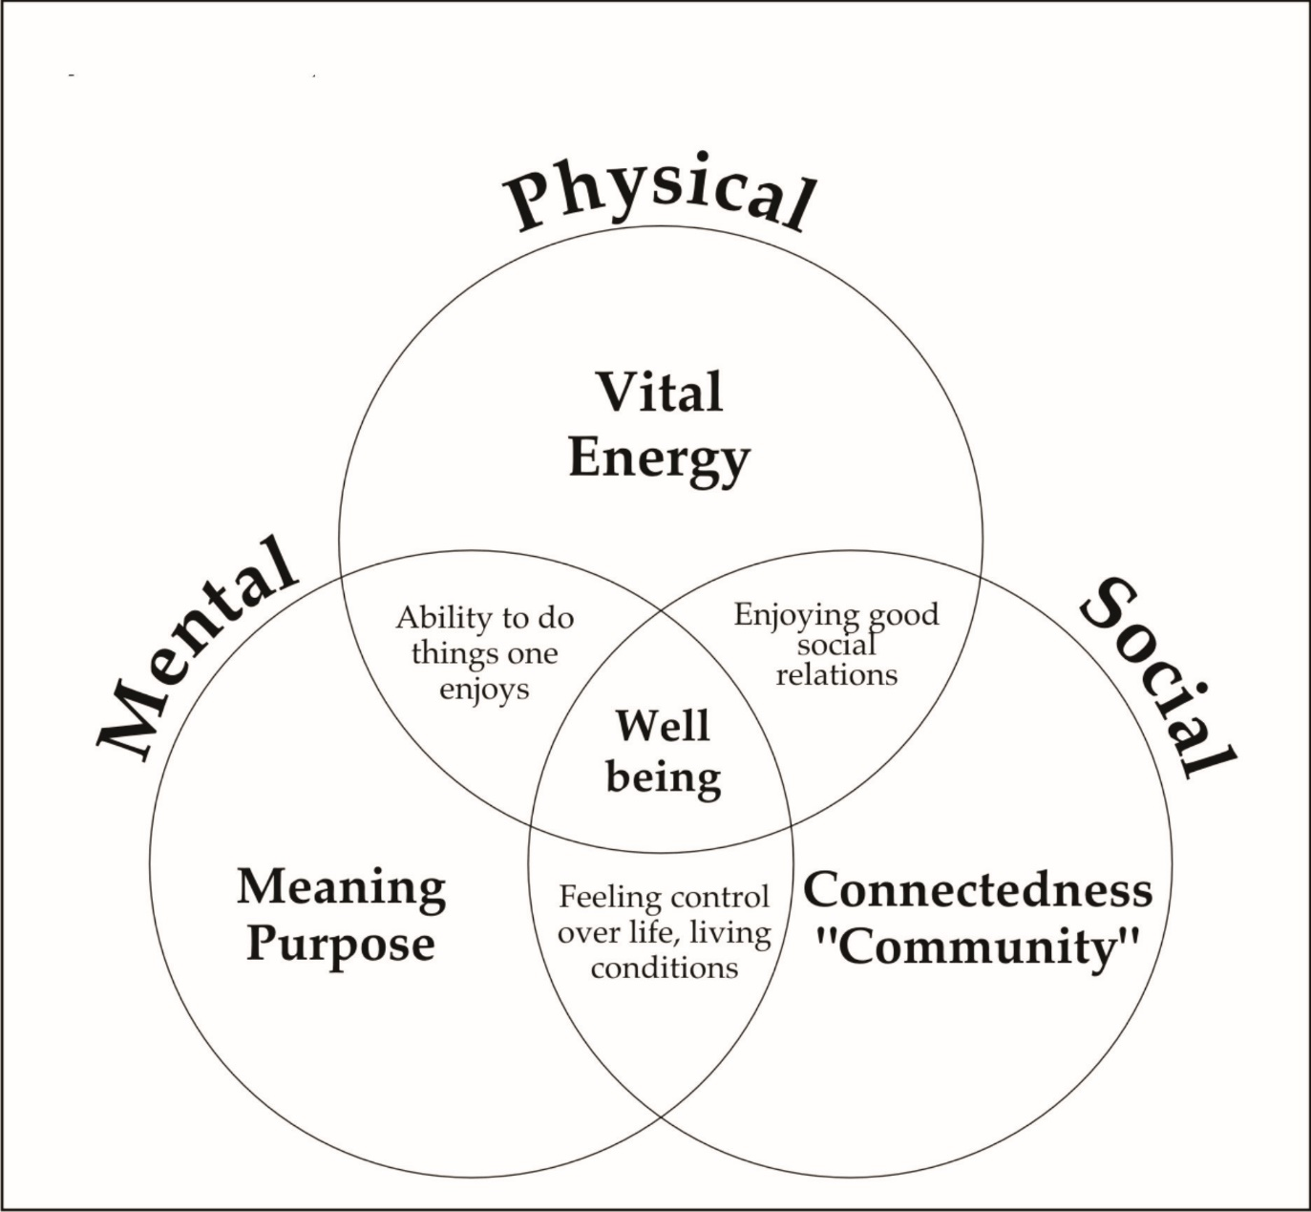
Our pupils' Health and Wellbeing is always in the forefront of our minds.
Our children have impressed us with how they continue to follow the rules and routines in place in school.
Health and Wellbeing of our children is promoted and explored daily, through topics and across the curriculum.
Thank you for your continued support.

Slide 6
Behaviour & Relationships
Early Intervention Policy
Children have had a settling in period at the beginning of this session. If necessary, we will contact you for your support if we have any concerns over your child's behaviour in school.
Positive Relationships Policy
At St. Patrick's, we are a welcoming Catholic community dedicated to nurturing every child's faith, wellbeing, and success through an inclusive, respectful, and supportive environment.
Our staff have collaboratively updated our Positive Relationships Policy to launch our new 'FRESH' Start element—an approach rooted in our Gospel Values, restorative conversations, early parent partnership, and UNCRC Class Charters to ensure every child feels welcomed, loved and supported to make positive choices.
St Patrick’s Promise
All pupils are aware of and regularly use the St Patrick’s Promise to help them to remember the expectations of them in school each day.

Slide 7


Slide 8


Slide 9
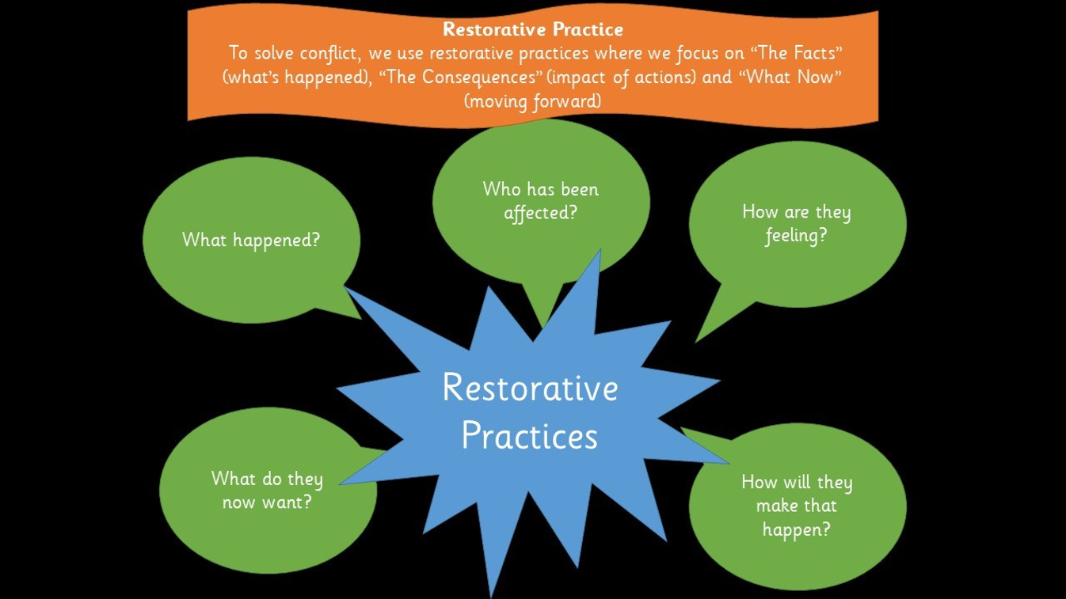

Slide 10
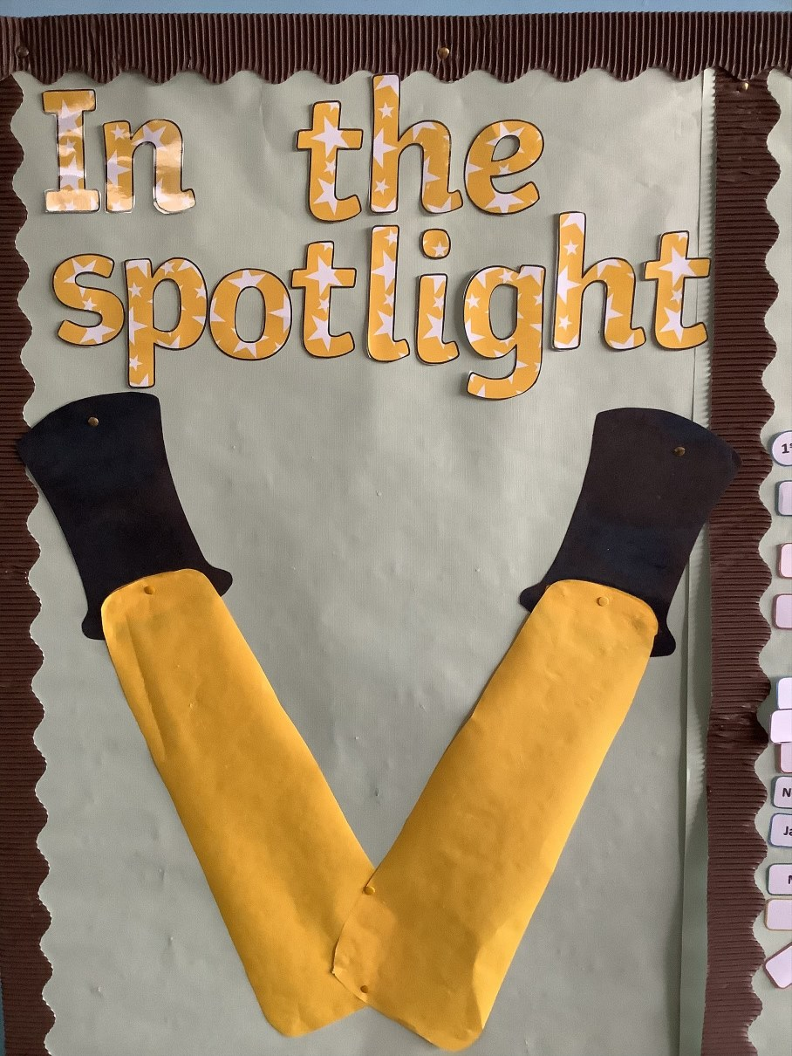
Positive Behaviour
Positive behaviour is recognised and celebrated throughout each day. Pupils are rewarded for demonstrating positive behaviour such as effort, kindness, respect and for displaying the Gospel Values.
We use our Recognition Boards to highlight the Gospel Values, positive behaviour and focused learning.
Our Recognition Board runs alongside our Class Charter, which Primary 3 created as a team to ensure they are all safe, happy and achieving within their classroom.

Slide 11

Head teacher awards will be given out on a monthly basis to children who demonstrate a positive attitude to learning and school life.
One child from each class will be nominated for this each month.

Slide 12
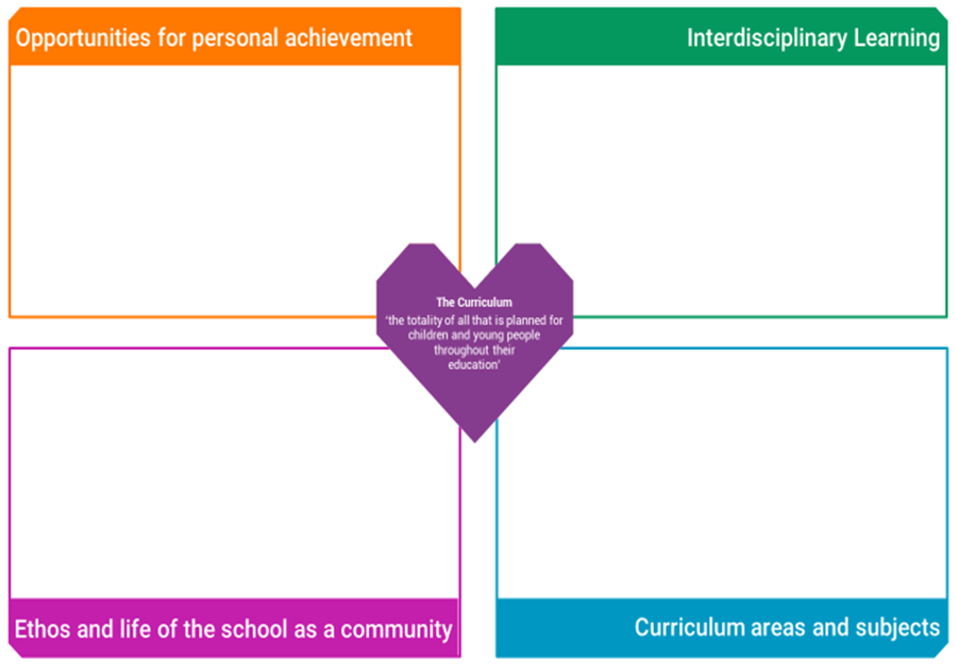
Notes:
A curriculum is all the learning and experiences planned for learners from their earliest years, through school and beyond. In Curriculum for Excellence, this learning can be planned for and experienced by learners across the four contexts for learning. The four contexts for learning in CfE allow schools flexibility to plan a curriculum that suits their context and setting.
Home School Links- Learners need opportunities to achieve in the classroom and beyond. This gives them a sense of satisfaction and builds confidence, motivation and resilience. All schools should plan to offer opportunities for achievement and to provide the support and encouragement which will enable learners to step forward and undertake new challenges. Schools should work closely with other organisations to help learners find information and opportunities to help them achieve. Please share wider achievements with us so we can acknowledge them in school also.

Slide 13


Building Thinking Classroom
What is a Building Thinking Classroom? A Building Thinking Classroom is an approach to learning that encourages children to think, talk, problem-solve, and work together rather than simply being shown how to complete a task. In a Building Thinking Classroom, children: Work collaboratively with classmates. Discuss and share ideas. Explore different ways to solve problems. Learn from mistakes and try new strategies. Develop confidence in explaining their thinking. Build resilience when faced with challenges. Why do we use it? Research shows that children learn more deeply when they actively engage with their learning. Rather than focusing only on getting the correct answer, children learn how to think critically, communicate their ideas, and work effectively with others.

Slide 14

Silver Reading Schools Accreditation Awarded June 2026
We have been on our Reading Schools journey in recent years and were delighted to receive this accreditation in recognition for the hard work that has gone in to building and sustaining a reading culture across our whole school community.
Next steps will be to continue this journey as we aim for our Gold Reading Schools Accreditation.
Thank you for your continued support!

Slide 15

Reading Resources
We have a wealth of resources to support our teaching and learning of reading in St Patrick’s across the levels. These come in physical and digital formats.
Physical Texts:
A wide range of Oxford Reading Tree resources
Oxford Reading Tree Classics
Treetops- Reflect Fiction and Non-Fiction
Chucklers
Greatest Stories
Project X Code
School and Class Library Books

Slide 16

Reading Home Learning
Following a trial within our Infant Department and considering pupil, parent and staff feedback we will soon be moving forward with a new online reading resource Oxford Reading Buddy. This can be used in class and at home to support, challenge and extend our teaching and learning of reading.
Provides a personalised E-Book Library that pupils can access at their reading level. This will be set by Class Teachers and monitored as they progress.
We have close links with Denny Library and would encourage pupils and parents to use this wonderful resource to explore and support them on their reading journey.
In addition, pupils will receive weekly spelling words shared via Bluesky and a termly
Home Learning grid incorporating other areas of the curriculunm.

Slide 17
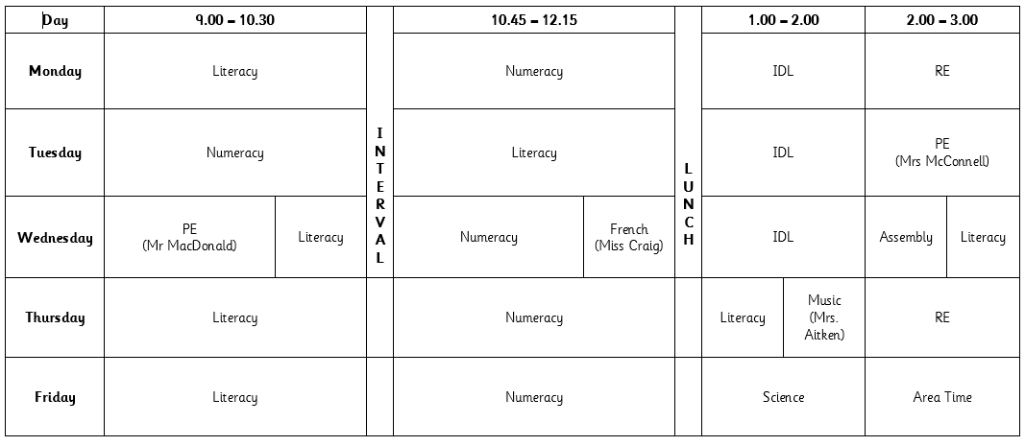
Timetable

Slide 18
Physical Education/Outdoor Learning
Mr MacDonald will be taking our class for P.E. on a Wednesday and children will participate with the class teacher on a Tuesday.
On both days where children have P.E. they should come to school dressed in their P.E kit - dark trousers, white top and school jumper/hoodie. P.E may take place outdoors, therefore children should come appropriately dressed for all weathers.
In order to be able to allow pupils to access our playing fields at PE times or playtimes and to participate fully in outdoor learning experiences, could we also ask that children bring an indoor pair of shoes to change into when returning into the building.

Slide 19
Environmental Changes – Session 2026 27
Primary 3 have remained in the infant area as normal, but due to class changes this year are joined by Primary 4 and Primary 4/3.
As we know, Primary 4s are no longer ‘infants’ therefore we will be seeking pupil ideas to name the 3 learning spaces for this session.

Slide 20
Community Hub – Breakfast Club
In coming weeks, we are delighted to be partnering with the ‘Magic Breakfast’ to ensure every primary school student starts the day with a breakfast, boosting concentration, energy, and readiness to learn. This initiative creates a supportive foundation that improves overall attendance and helps all children reach their full academic potential.
We welcome any child to access the bagel station for a grab and go breakfast snack on route to their class in the morning. In addition, cereals will be available as well as fruit baskets in every class – available to all.
We are almost ready to launch our Breakfast Club so look out for more information via email soon.

Slide 21


Article 12 Committee
Pupil Voice

Slide 22
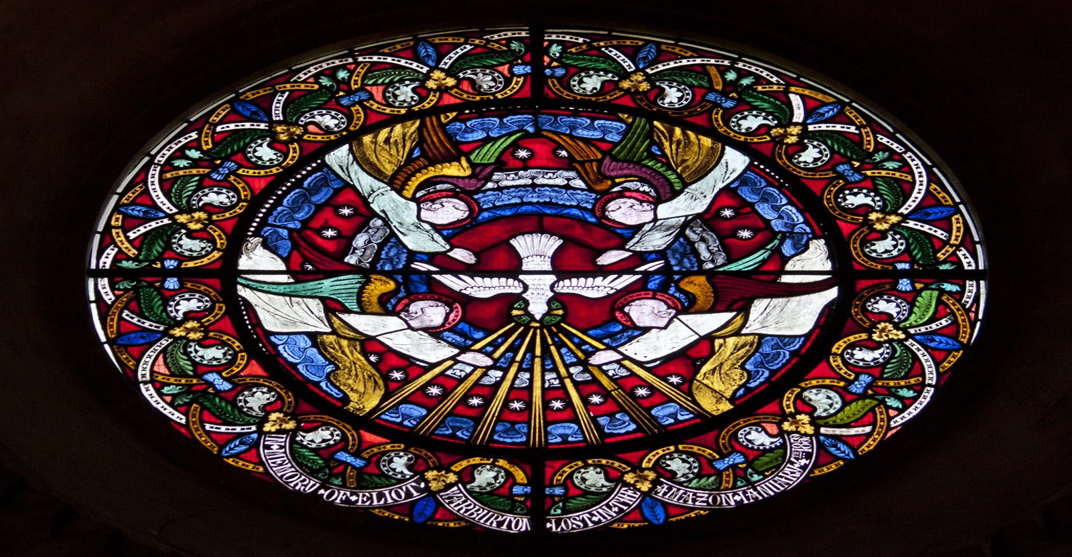
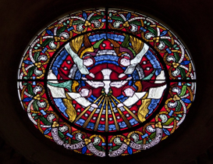
Sacramental Preparation
P3 Sacramental preparation for Sacrament of Reconciliation will begin in the New Year.
Preparation for this sacrament will involve input and support through discussion and home learning activities, these will be shared as we begin our Sacramental journey in class.
God’s Loving Plan
GLP will take place in the final term of Primary 3 and parents will be notified and provided with necessary information prior to this.

Slide 23
Nativity
Excitingly, P3 will be taking on the lead roles in our Nativity Performance this year.
Watch this space...

Slide 24

Health Promoting Schools
Healthy Snacks Please encourage your child to bring a healthy snack to school. Please be aware we are a nut free and in addition, our lunch hall is egg free. We kindly ask that all families adhere to this when selecting your child’s snack/packed lunch.
As snack time is very brief, please provide your child with only 1 item.
Water Bottles
Your child will be able to access water throughout the day from their water bottles. Please provide water each morning and bottles can be refilled at various times throughout day.
Juice may be brought for snack/lunchtime only.

Slide 25
As the number of children and staff who have moderate to severe nut allergies are increasing can we as our families to please be mindful of the food items sent to school - some snacks do not obviously contain nuts or traces of nuts such as Kinder Bueno or hippo bars.

Slide 26
Communication
School email address – stpatricksprimaryschool@education.falkirk.sch.uk
School main office phone number – 01324 508840
Website - https://www.st-patricks.falkirk.sch.uk/
Our Parent Communication Policy is available on our website.
If you feel your family requires a greater level of support in order to improve your child(rens) attendance, please contact the school on 01324 508840 or via stpartricksprimaryschool@education.falkirk.sch.uk and Ms Flaherty will get back to you as soon as possible.

Slide 27

Follow your child's class on Bluesky - our school social media platform.
@mrsmc-stp.bsky.social

