Slide 1

Primary 2
Meet the Teacher

Slide 2
Information Powerpoint Agenda
Teacher & Senior Leadership Team Introduction
School Vision
Health & Wellbeing
Behaviour and Positive Relationships
Environmental Changes
Community Hub – Breakfast Club
Timetables
Classroom Routines/Expectations
Four Context for Learning
Reading/Home Learning/Sharing the Learning
God’s Loving Plan
Health Promoting Schools
Communication and Bluesky

Slide 3

Mrs Young
(Mon-Wed)
Mrs McRae
(Thurs-Fri)

Slide 4

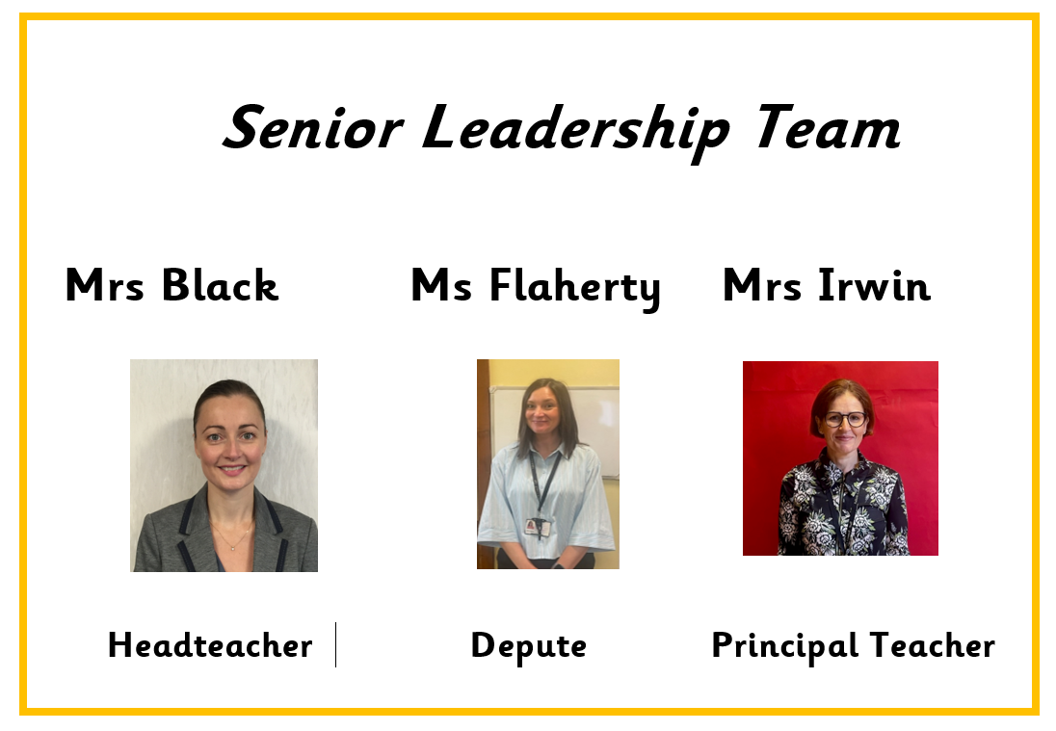

Slide 5
ONE BIG FAMILY, ONE GREAT SCHOOL
Our Vision
St Patrick’s Primary School and Early Learning Centre is a community of faith and a family of learners.
We set high expectations of behaviour and effort, and we work closely with parents, parish and partners to guide and support our children in their educational and spiritual journey – fostering a love of learning and preparing them for the future.
We respect the rights of all members of our community and promote children’s rights from the United Nations Convention on the Rights of the Child (UNCRC) throughout the school.

Slide 6

Our pupils' Health and Wellbeing is always in the forefront of our minds.
Our children have impressed us with how they continue to follow the rules and routines in place in school.
Health and Wellbeing of our children is promoted and explored daily, through topics and across the curriculum.
Thank you for your continued support.

Slide 7
Behaviour & Relationships
Early Intervention Policy
Children have had a settling in period at the beginning of this session. If necessary, we will contact you for your support if we have any concerns over your child's behaviour in school.
Positive Relationships Policy
At St. Patrick's, we are a welcoming Catholic community dedicated to nurturing every child's faith, wellbeing, and success through an inclusive, respectful, and supportive environment.
Our staff have collaboratively updated our Positive Relationships Policy to launch our new 'FRESH' Start element—an approach rooted in our Gospel Values, restorative conversations, early parent partnership, and UNCRC Class Charters to ensure every child feels welcomed, loved and supported to make positive choices.
St Patrick’s Promise
All pupils are aware of and regularly use the St Patrick’s Promise to help them to remember the expectations of them in school each day.

Slide 8



Slide 9

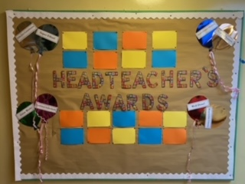
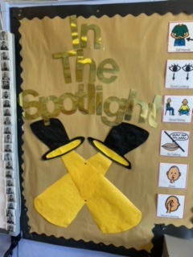

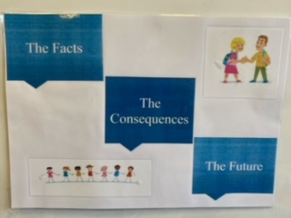
Behaviour

Slide 10


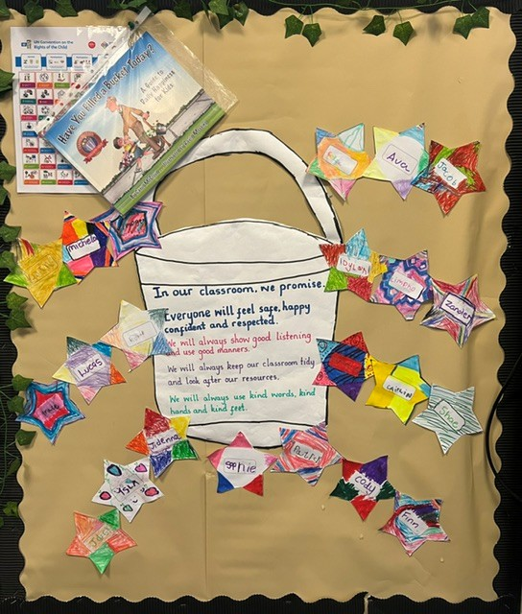

Class Charter

Slide 11
Environmental Changes – Session 2026 27
Primary 1, 2 and 3 have remained in the infant area as normal, but due to class changes this year are joined by Primary 4 and Primary 4/3.
As we know, Primary 4s are no longer ‘infants’ therefore we will be seeking pupil ideas to name the 3 learning spaces for this session.

Slide 12

Community Hub – Breakfast Club
Coming Soon!

Slide 13
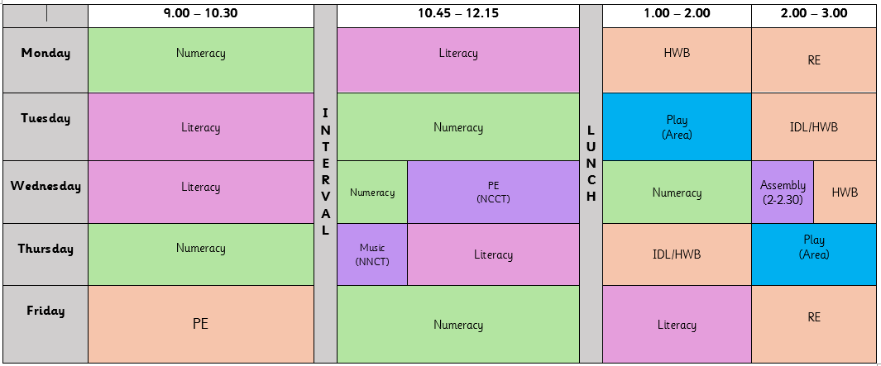
Timetable

Slide 14
Physical Education/Outdoor Learning
Mr MacDonald will be taking our class for P.E. on a Wednesday and children will participate with the class teacher on a Friday.
On both days where children have P.E. they should come to school dressed in their P.E kit - dark trousers, white top and school jumper/hoodie. P.E may take place outdoors therefore, children should come appropriately dressed for all weathers.
In order to be able to allow pupils to access our playing fields at playtimes could we also ask that children bring an indoor pair of shoes to change into when returning into the building.

Slide 15
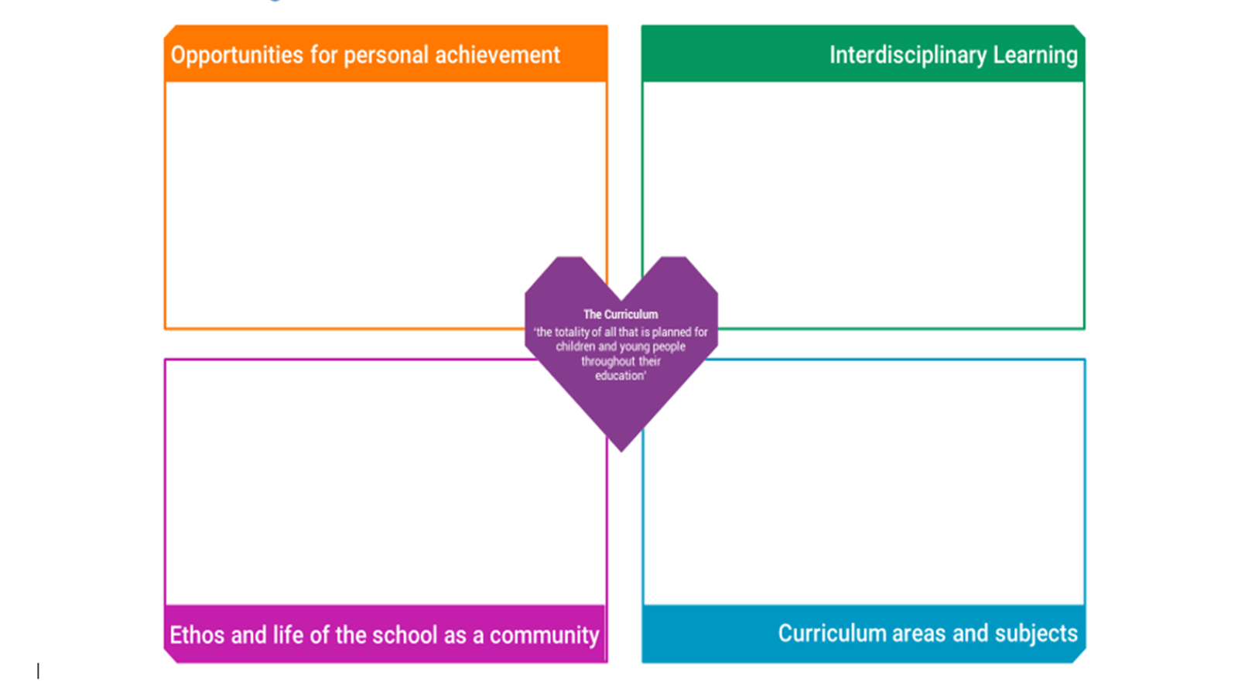

Slide 16

Reading
St Patrick’s P.S.

Slide 17

Silver Reading Schools Accreditation Awarded June 2026
We have been on our Reading Schools journey in recent years and were delighted to receive this accreditation in recognition for the hard work that has gone in to building and sustaining a reading culture across our whole school community.
Next steps will be to continue this journey as we aim for our Gold Reading Schools Accreditation.
Thank you for your continued support!

Slide 18

Reading Resources
We have a wealth of resources to support our teaching and learning of reading in St Patrick’s across the levels. These come in physical and digital formats.
Physical Texts:
A wide range of Oxford Reading Tree resources
Oxford Reading Tree Classics
Treetops- Reflect Fiction and Non-Fiction
Chucklers
Greatest Stories
Project X Code
School and Class Library Books

Slide 19



Reading Eggs Programme
We have access to the Digital Reading Eggs Programme within our Primary 2, 3, 4 and Primary 6 and 7 stages for class and home use.
Reading Eggs Programme:
Fast Phonics
Reading Eggs
Reading Eggspress

Slide 20



Reading Eggs Programme
Is a progressive programme that supports and challenges pupils at their own level.
Science of Reading’s five pillars of literacy
phonemic awareness
phonics
vocabulary
fluency
Comprehension

Slide 21

Reading Home Learning
Following a trial within our Infant Department and considering pupil, parent and staff feedback we will soon be moving forward with a new online reading resource Oxford Reading Buddy. This can be used in class and at home to support, challenge and extend our teaching and learning of reading.
Provides a personalised E-Book Library that pupils can access at their reading level. This will be set by Class Teachers and monitored as they progress.
We have close links with Denny Library and would encourage pupils and parents to use this wonderful resource to explore and support them on their reading journey.

Slide 22
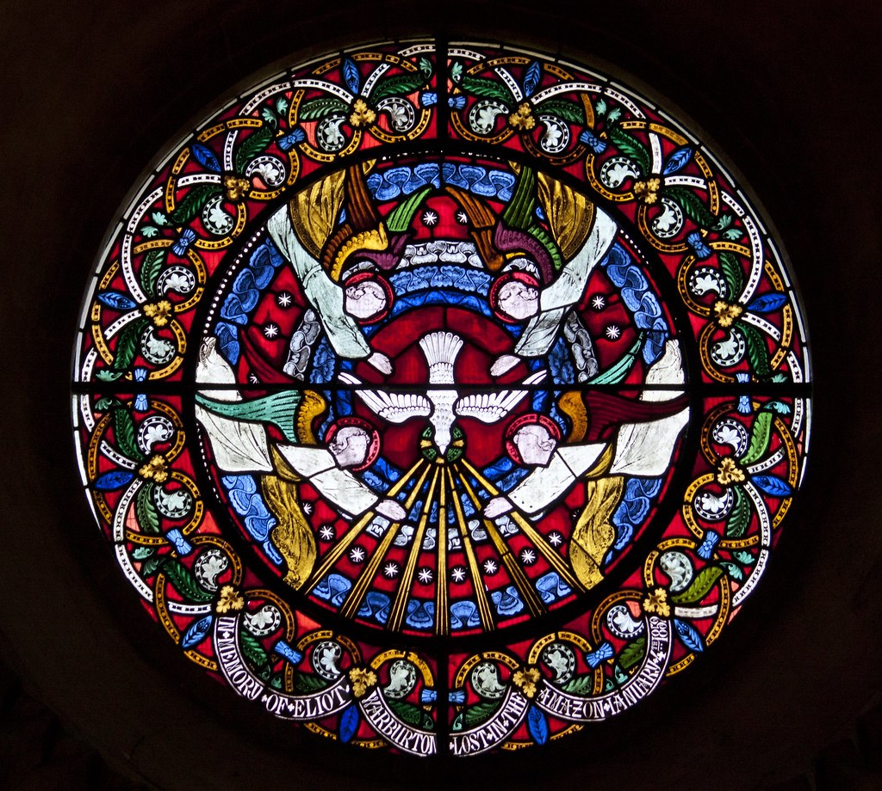

Slide 23
God’s Loving Plan
GLP will take place in the final term of Primary 2 and parents will be notified and provided with necessary information prior to this.

Slide 24

Health Promoting Schools
Healthy Snacks Please encourage your child to bring a healthy snack to school. Please be aware we are a nut free and in addition, our lunch hall is egg free . We kindly ask that all families adhere to this when selecting your child’s snack/packed lunch.
As snack time is very brief, please provide your child with only 1 item.
Water Bottles
Your child will be able to access water throughout the day from their water bottles. Please provide water each morning and bottles can be refilled at various times throughout day.
Juice may be brought for snack/lunchtime only.

Slide 25


Slide 26
Communication
School email address – stpatricksprimaryschool@education.falkirk.sch.uk
School main office phone number – 01324 508840
Website - https://www.st-patricks.falkirk.sch.uk/
Our Parent Communication Policy is available on our website
If you feel your family requires a greater level of support in order to improve your child(rens) attendance please contact the school on 01324 508840 / stpartricksprimaryschool@education.Falkirk.sch.uk and Ms Flaherty will get back to you as soon as possible.

Slide 27

Follow your child's class on Bluesky - our school social media platform.
@mrsyo-stp.bsky.social

