Slide 1


Mrs Mutch & Mrs Roche
Meet The Teacher
Tuesday 1st September 2026

Slide 2

BACK!!

Slide 3
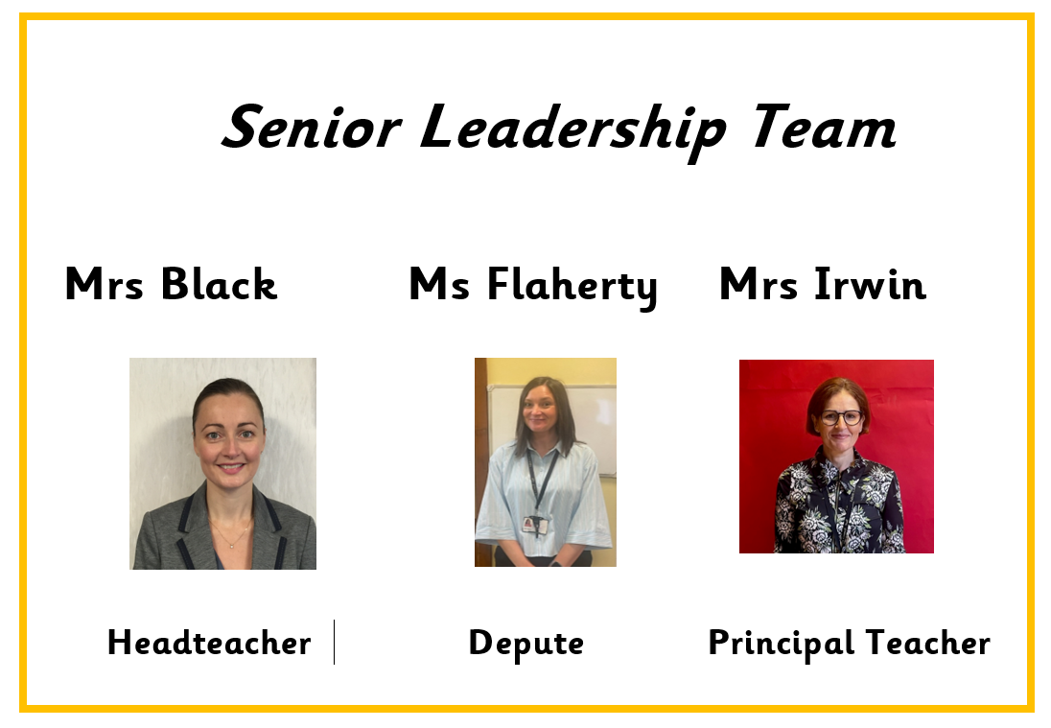

Slide 4
ONE BIG FAMILY, ONE GREAT SCHOOL
Our Vision
St Patrick’s Primary School and Early Learning Centre is a community of faith and a family of learners.
We set high expectations of behaviour and effort, and we work closely with parents, parish and partners to guide and support our children in their educational and spiritual journey – fostering a love of learning and preparing them for the future.
We respect the rights of all members of our community and promote children’s rights from the United Nations Convention on the Rights of the Child (UNCRC) throughout the school.

Slide 5


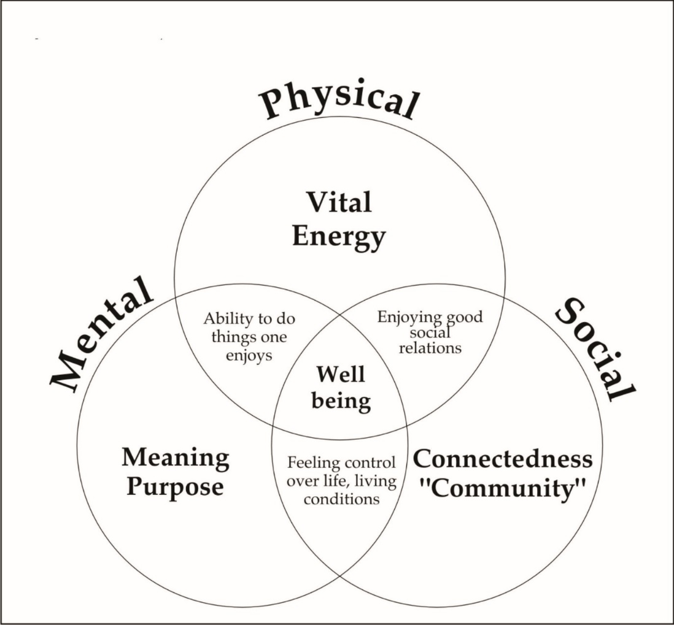

Our pupils' Health and Wellbeing is always in the forefront of our minds.
Our children have impressed us with how they continue to follow the rules and routines in place in school.
Health and Wellbeing of our children is promoted and explored daily, through topics and across the curriculum.
Thank you for your continued support.

Slide 6
Behaviour & Relationships
Early Intervention Policy
Children have had a settling in period at the beginning of this session. If necessary, we will contact you for your support if we have any concerns over your child's behaviour in school.
Positive Relationships Policy
At St. Patrick's, we are a welcoming Catholic community dedicated to nurturing every child's faith, wellbeing, and success through an inclusive, respectful, and supportive environment.
Our staff have collaboratively updated our Positive Relationships Policy to launch our new 'FRESH' Start element—an approach rooted in our Gospel Values, restorative conversations, early parent partnership, and UNCRC Class Charters to ensure every child feels welcomed, loved and supported to make positive choices.
St Patrick’s Promise
All pupils are aware of and regularly use the St Patrick’s Promise to help them to remember the expectations of them in school each day.
Notes:
Our Restorative Approach
We help children to understand what has happened, think about how others may feel, consider what they could do differently and, where appropriate, repair and move forward.
Our approach is centred on helping children learn from their experiences, recognising that a difficult moment does not define a child

Slide 7


Notes:
Parents role - modelling and supporting school in the promotion of these values

Slide 8

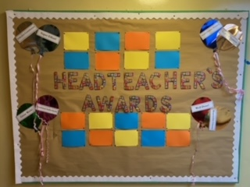
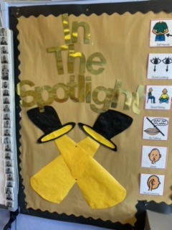

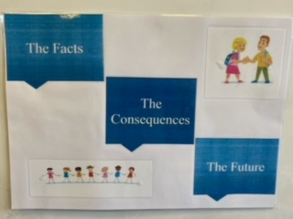
Behaviour
Notes:
Our pupils health and well being is always in the forefront of minds.
St Patrick’s is a place where all are welcomed, loved, forgiven and encouraged to live out our Gospel Values. Our St Patrick’s Promise was created by our pupils and helps us to demonstrate respect, kindness and a positive attitude.
We also recognise and celebrate positive behaviour in a variety of ways including Star of the Week, Recognition Boards (“In the Spotlight”), Monthly Head Teacher’s Certificates and Restorative Practice.
We appreciate your continued support in encouraging children to follow our St Patrick’s Promise .

Slide 9
Transitioning to P1
Starting Primary 1 is a huge transition. At this age, children are still developing their:
Emotional regulation and impulse control
Communication and problem-solving skills
Understanding of boundaries and the impact of their actions
Ability to manage big feelings and frustrations
Social skills and relationships with others
As children develop these skills, there will naturally be times when they find things difficult, make mistakes or make choices that aren’t helpful to themselves or others.
These moments are not ignored. Instead, they provide valuable opportunities for children to learn, reflect and develop the skills they need to make positive choices.

Slide 10
Working Together
We value a strong partnership between home and school.
By communicating openly, we can work together to support our children as they develop confidence, independence, positive relationships and the skills they need to navigate school life.
Children are learning every day, and mistakes are opportunities to learn, reflect and grow
ONE BIG FAMILY, ONE GREAT SCHOOL

Slide 11
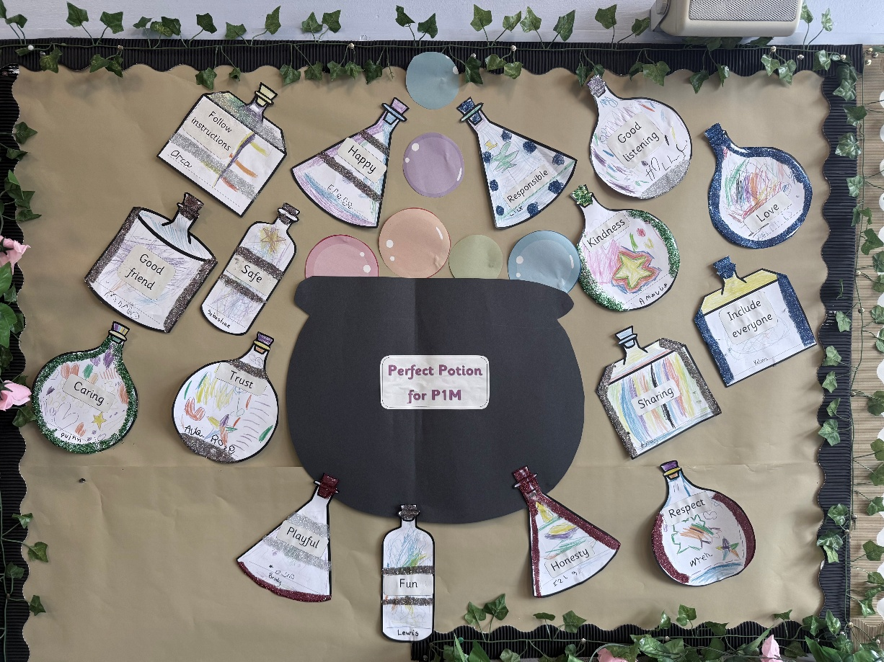
Class Charter
Notes:
This is our class charter which is our class promise that we make at the start of every year on our journey through St Patrick’s. The children make this promise, decided to create a potion and thought about the perfect ingredients for their class using UNCRC – Right of the child. All agree to keep this promise.

Slide 12


Slide 13
God’s Loving Plan
This combines health and RE education, specifically focusing on relationships.
Taught from P1-P7 at appropriate level.
P1 tasks completed in class in the final term.
Notes:
GLP is our programme of learning which combines health and re education with a focus on relationships.

Slide 14
Health Promoting School
Physical Education
Mr MacDonald will be taking our class for P.E. on a Wednesday and children will participate with the class teacher on a Tuesday.
On both days where children have P.E. they should come to school dressed in their P.E kit - dark trousers, white top and school jumper/hoodie. P.E may take place outdoors therefore, children should come appropriately dressed for all weathers.
In order to be able to allow pupils to access our playing fields at playtimes could we also ask that children bring an indoor pair of shoes to change into when returning into the building.
Notes:
Please ensure children adhere to our uniform policy especially during P.E. days.
Plain T-shirt's preferably white, dark bottoms and green jumper.
Outdoor learning will take place throughout the week at anytime reflecting a true interdisciplinary learning approach. Please ensure appropriate clothing is always available as we will be out in all weathers.

Slide 15
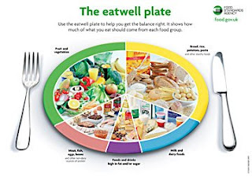
Health Promoting Schools
Healthy Snacks Please encourage your child to bring a healthy snack to school. Please be aware we are a nut free and in addition, our lunch hall is egg free. We kindly ask that all families adhere to this when selecting your child’s snack/packed lunch.
As snack time is very brief, please provide your child with only 1 item.
Water Bottles
Your child will be able to access water throughout the day from their water bottles. Please provide water each morning and bottles can be refilled at various times throughout day.
Juice may be brought for snack/lunchtime only.
Notes:
As the number of children and staff who have moderate to severe nut allergies are increasing can we as our families to please be mindful of the food items sent to school - some snacks do not obviously contain nuts or traces of nuts such as Kinder Bueno or hippo bars.

Slide 16
Magic Breakfast
We are delighted to be partnering with the ‘Magic Breakfast’ to ensure every primary school student starts the day with a breakfast, boosting concentration, energy, and readiness to learn.
This initiative creates a supportive foundation that improves overall attendance and helps all children reach their full academic potential. We welcome any child to access the bagel station for a grab and go breakfast snack on route to their class in the morning. In addition, cereals will be available as well as fruit baskets in every class – available to all.
We are almost ready to launch our Breakfast Club so look out for more information via email soon.

Slide 17
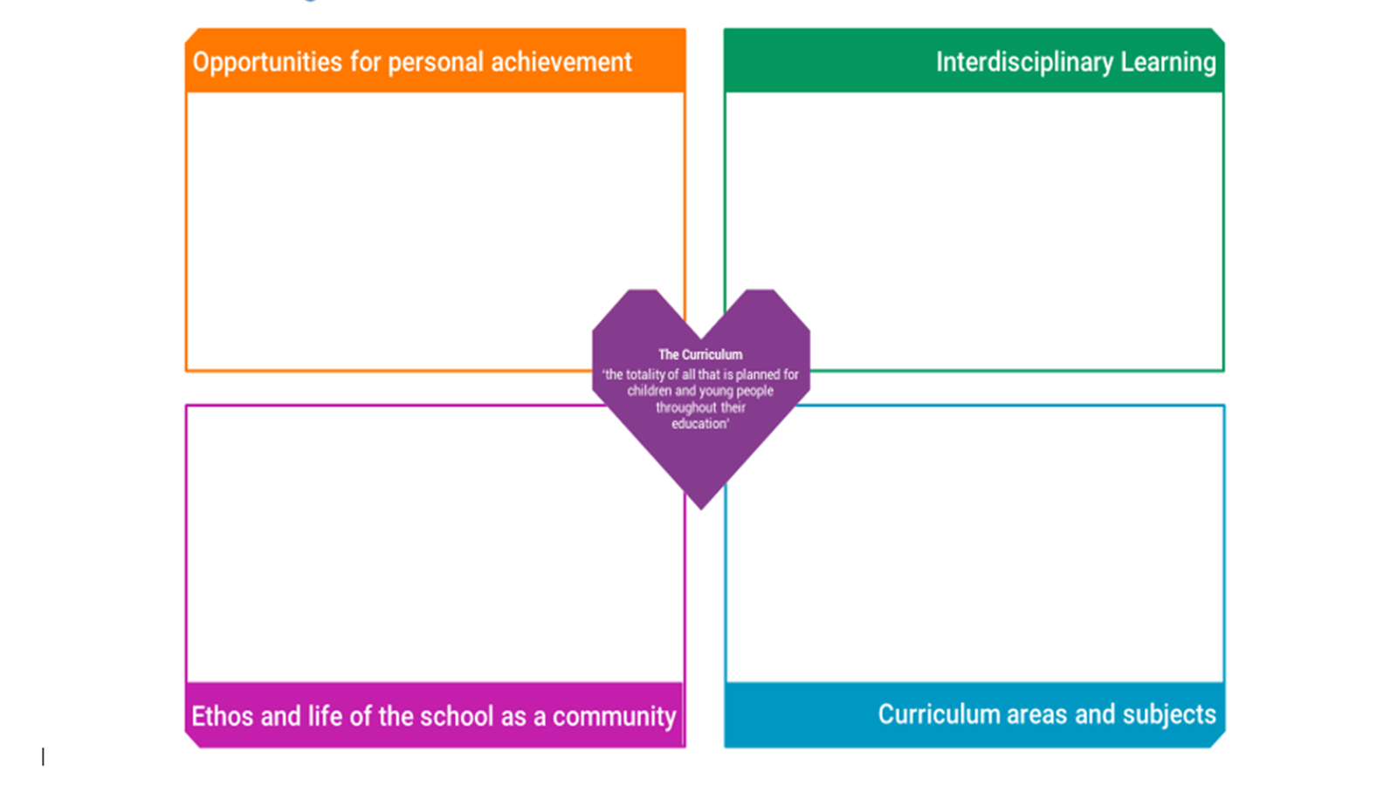
Notes:
A curriculum is all the learning and experiences planned for learners from their earliest years, through school and beyond. In Curriculum for Excellence, this learning can be planned for and experienced by learners across the four contexts for learning. The four contexts for learning in CfE allow schools flexibility to plan a curriculum that suits their context and setting.
Home School Links- Learners need opportunities to achieve in the classroom and beyond. This gives them a sense of satisfaction and builds confidence, motivation and resilience. All schools should plan to offer opportunities for achievement and to provide the support and encouragement which will enable learners to step forward and undertake new challenges. Schools should work closely with other organisations to help learners find information and opportunities to help them achieve. Please share wider achievements with us so we can acknowledge them in school also.

Slide 18
Term 1 Overview
Play-Based Learning – settling in through fun and exploration
Rules & Routines – building confidence and independence in school life
Pre-Writing & Fine Motor Skills – strengthening little hands for writing
Numeracy – exploring numbers 1–10
Literacy – rhyming then initial sounds
Health & Wellbeing – focusing on class rules, routines, and positive relationships
YMI – Yorik will return to P1 for 10 week block
RME – God made me
PE – listening games and moving with control

Slide 19
Nativity
Excitingly, P1 will help support our school Nativity Performance this year. Watch this space...

Slide 20
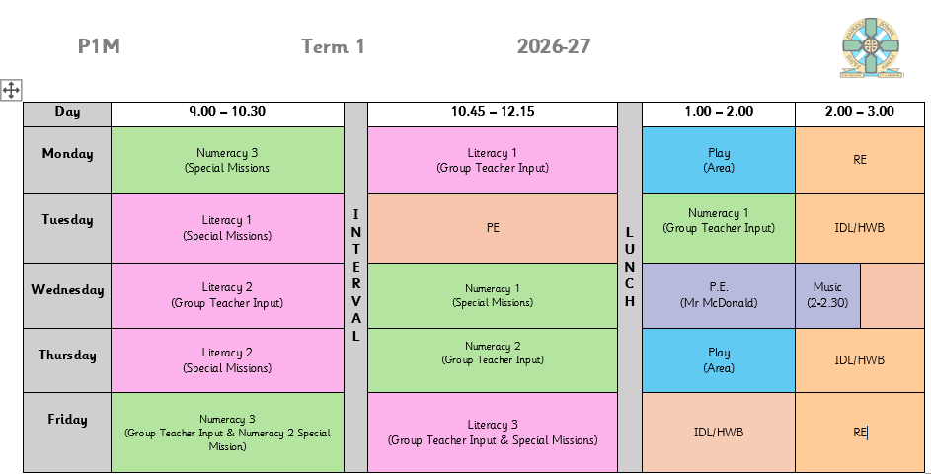
Timetable

Slide 21
What does Teaching and Learning
look like in our P1 Class?
Teacher Led
• Whole class, group, individual – ‘Together Time’ used for focussed learning with teacher.
• Explicit coverage of Experiences and Outcomes.
Teacher Initiated
• Literacy and Numeracy focus tasks – called ‘Special Missions.’
• Individual, paired and group activities linked to ‘Together Time.’
Child Initiated
• Carefully planned play provocations both in the classroom and in the area.
• Teachers’ role changes…
• Facilitating
• Supporting
• Observing
Notes:
In Primary 1, we aim to deliver high quality, creative and engaging learning experiences for your child by allowing them to be active and independent in their learning.
In class, your child will interact with a variety of active and engaging learning experiences in different forms – see slide.
Child Initiated – big focus just now on our continuous provision – this refers to the various play experiences your child accesses on a day to day basis independently. A lot of time, effort and planning is put in to ensure these experiences are valuable and worthwhile for your children and that they are getting something out of these experiences – whether this be related to the curriculum or to their own personal development.

Slide 22
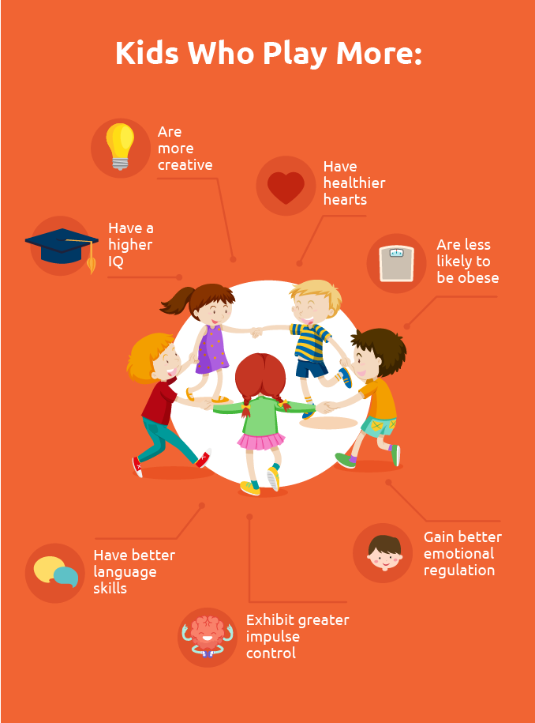
Why is Play Important for Learning?
Play can help children to develop positive dispositions for learning…
Notes:
Supports childrens ability to:
Develop their interests
° be willing to explore, experiment and try out new things
° know how and when to seek help
° be inventive – creating problems, and finding solutions
° be fully engaged and involved – concentrating, sustaining interest and
making choices and decisions
° play and work collaboratively with peers and adults
° find alternative strategies if things don’t always go as planned
° manage themselves and develop their awareness of others
risk assess
° understanding the perspectives and emotions of other people
Develop their social and communication skills
These are all the reasons why we have chosen to really drive and focus on a play based approach to learning and teaching in primary 1 this session.

Slide 23
How can you help at home?
Some Tips and Ideas
Literacy
Read with your child.
Practise letter names and letter sounds.
Help your child write their name.
Practise holding and controlling a pencil – birdy grip.
Numeracy
Counting – forwards and backwards.
Number recognition.
Assigning objects to numbers.
Number recognition and formation.
Notes:
Literacy
Read with your child as often as possible. When you are reading together, talk to your child about the story – ask questions and make observations to support their comprehension.
Support your child’s understanding of the difference between letter sounds and names. Just now, focus on developing their awareness of the sounds that letters make when used in a word.
Help your child practise writing their name.
Work with your child on their pencil control and letter formation. Encourage them to use the ‘birdy grip’ if they are still finding it difficult to hold their pencil or pen correctly.
Numeracy
Support your child by helping them to count to 10, 20 and beyond if they are able! Search ‘Jack Hartmann’ on YouTube for lots of super songs to help engage your child.
Practise instant recognition of numbers – try this using random numbers or numbers not in the correct order to avoid rote memorisation.
When counting, remember to practise counting forwards and backwards – this will be beneficial when your child begins adding and subtracting.
Ask your child to ‘show you’ a number – it could be using their fingers, toys, pencils, stones… anything at all! This will ensure your child is able to fully understand and assign objects to numbers.
Practise correct formation of numbers – this is a big focus just now! Use rhymes and songs to help (see next slide).

Slide 24
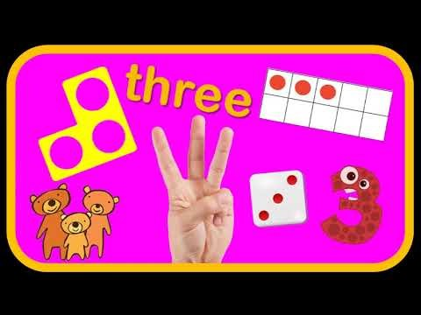

Videos to Support Number and Letter Formation

Slide 25

Silver Reading Schools Accreditation Awarded June 2026
We have been on our Reading Schools journey in recent years and were delighted to receive this accreditation in recognition for the hard work that has gone in to building and sustaining a reading culture across our whole school community.
Next steps will be to continue this journey as we aim for our Gold Reading Schools Accreditation.
Thank you for your continued support!

Slide 26

Home Learning
We will begin to share home learning on the 14th September.
Initially, this will include:
A paper copy of your child’s phonics focus (sounds and tricky words).
Login details for BugClub – online reading scheme where your child will be assigned a reading book every two weeks linked to the sounds they are learning in class.

Slide 27
Home Learning
After our October holiday you will also receive termly grid incorporating other areas of the curriculum, with activities which can be completed at your own pace. You will receive a paper copy of these, and they will also be shared via Bluesky along with words featuring focus sounds.
Please note, there is no expectation for work to be returned to school however we will continue to celebrate your child’s success and achievements throughout the session.

Slide 28

Follow your child's class on Bluesky - our school social media platform.
@mrsm-stp.bsky.social

Slide 29
Helicopter Stories – Miss Murphy
To support transition from nursery to Primary 1
Children explore the world of story writing. They have the chance to see how their story telling is composed on a page and then see their story to come to life.
Encourages the children to be respectful, listening to other children's stories and developing turn taking.
Children take turns to act out each other's stories and bring them to life.

Slide 30
Thank you!

Slide 31
Communication
School email address – stpatricksprimaryschool@education.falkirk.sch.uk
School main office phone number – 01324 508840
Website - https://www.st-patricks.falkirk.sch.uk/
If you feel your family requires a greater level of support in order to improve your child(rens) attendance please contact the school on 01324 508840 / stpartricksprimaryschool@education.falkirk.sch.uk and Mrs Flaherty will get back to you as soon as possible.
‘One BIG Family, One GREAT School!’.

