Slide 1
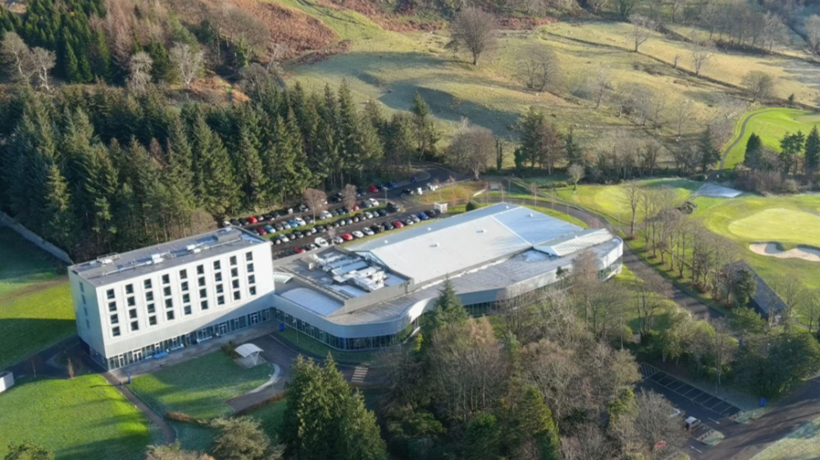

sportscotland National Sports Training Centre Inverclyde
Gareth Turner, Sports Programme Officer

Slide 2
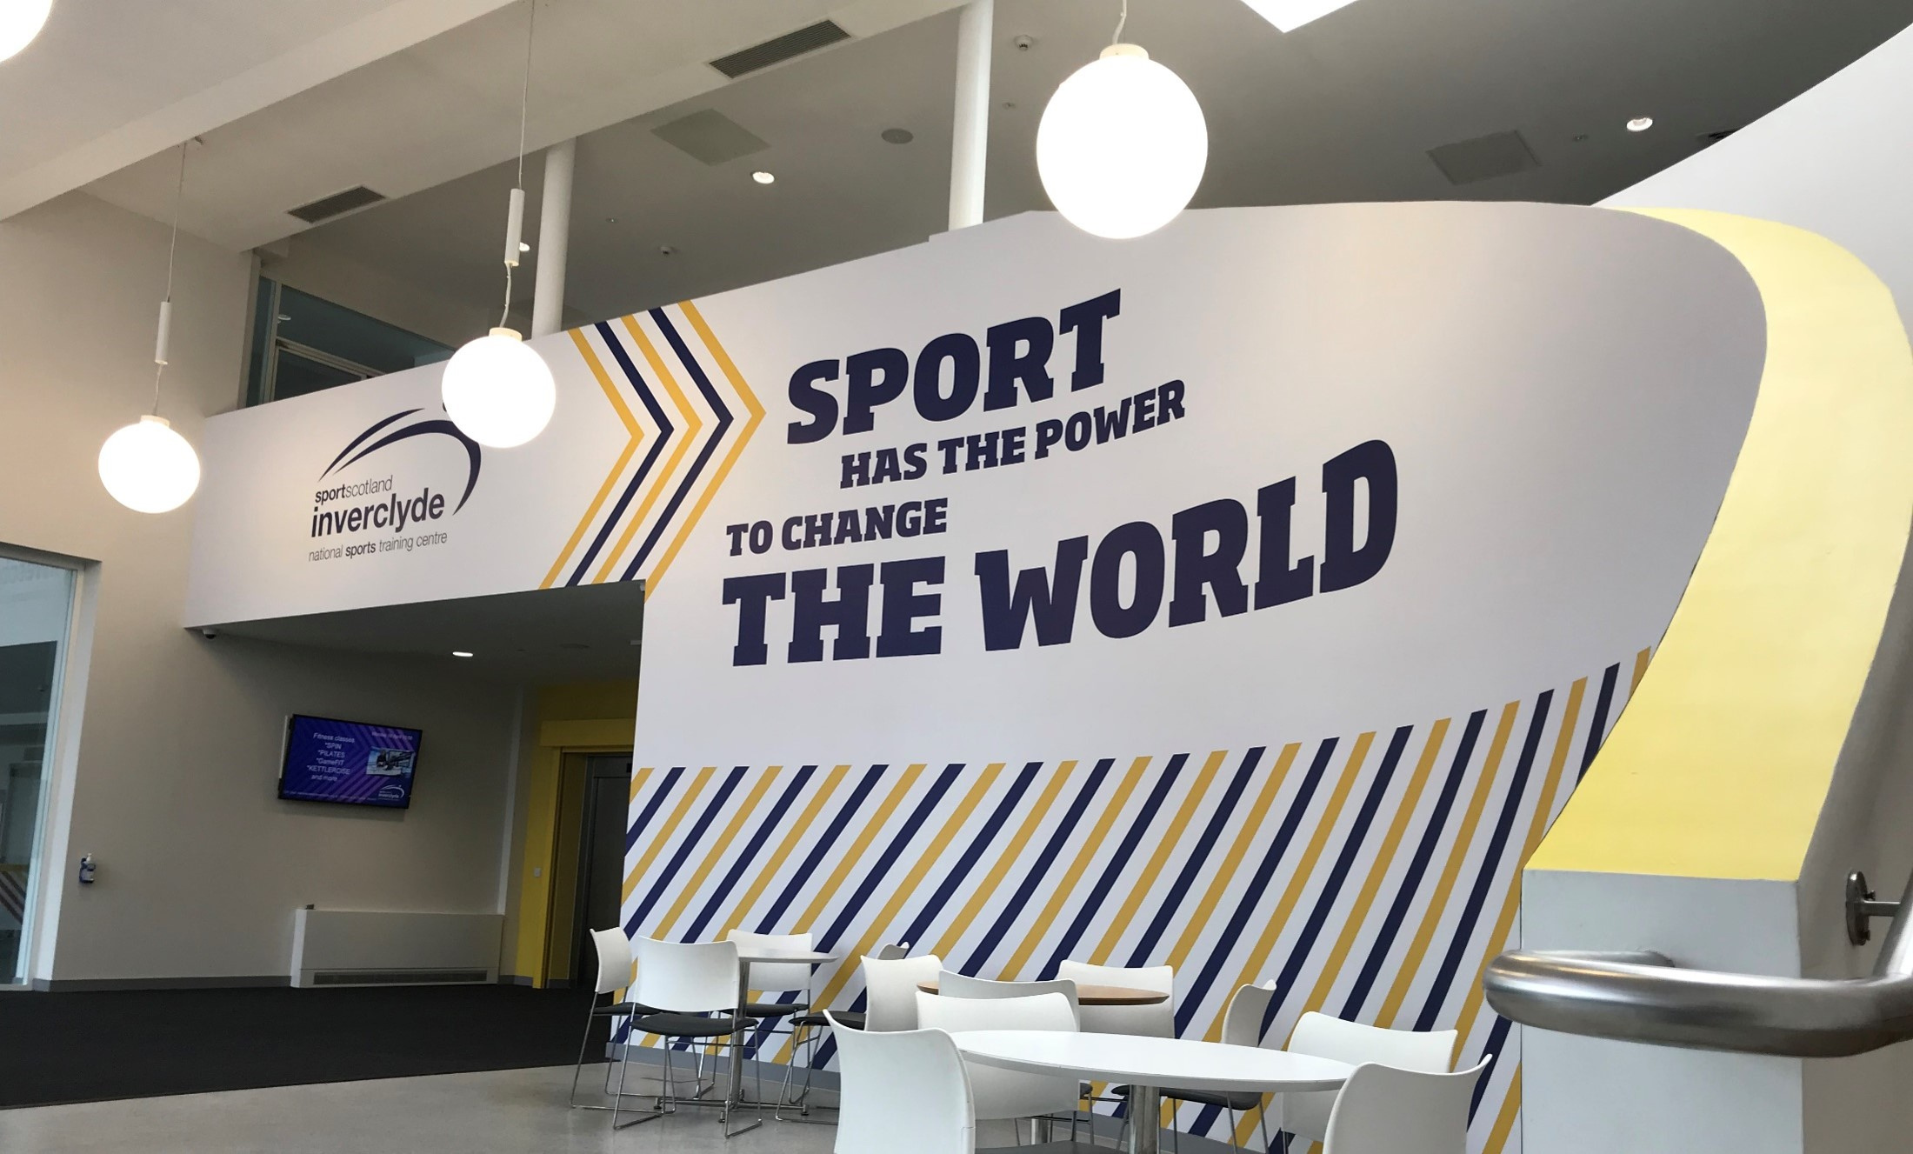
An active Scotland where everyone benefits from sport

Slide 3
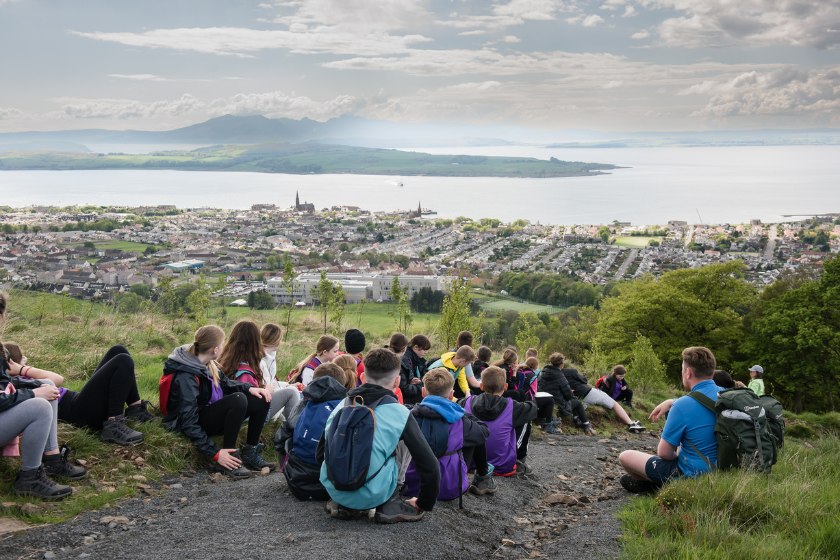
Why Inverclyde
  60+ years experience delivering school residentials
  Inclusive
  Blend of indoor and outdoor activities
  Links to the Curriculum

Slide 4
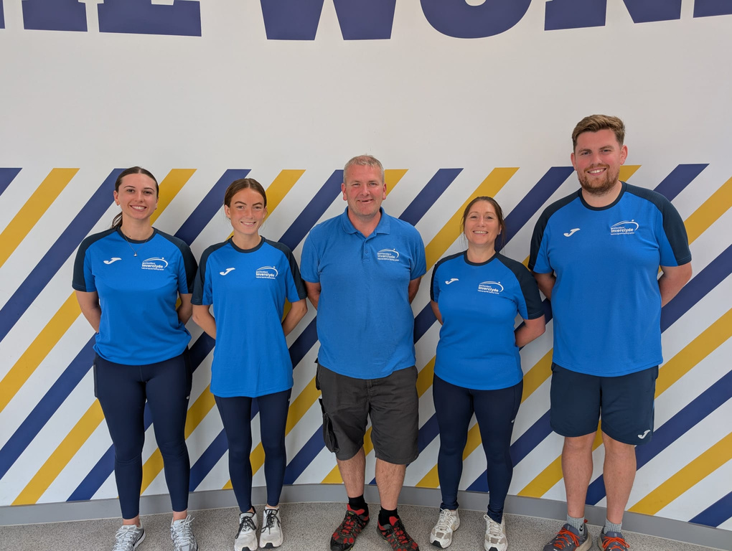
Our team
  Members of the PVG scheme
  Qualified and experienced in sports and activity delivery
  Knowledge of the outdoor sector
  Create powerful learning opportunities during each session

Slide 5
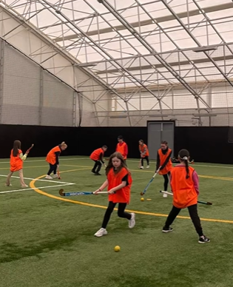
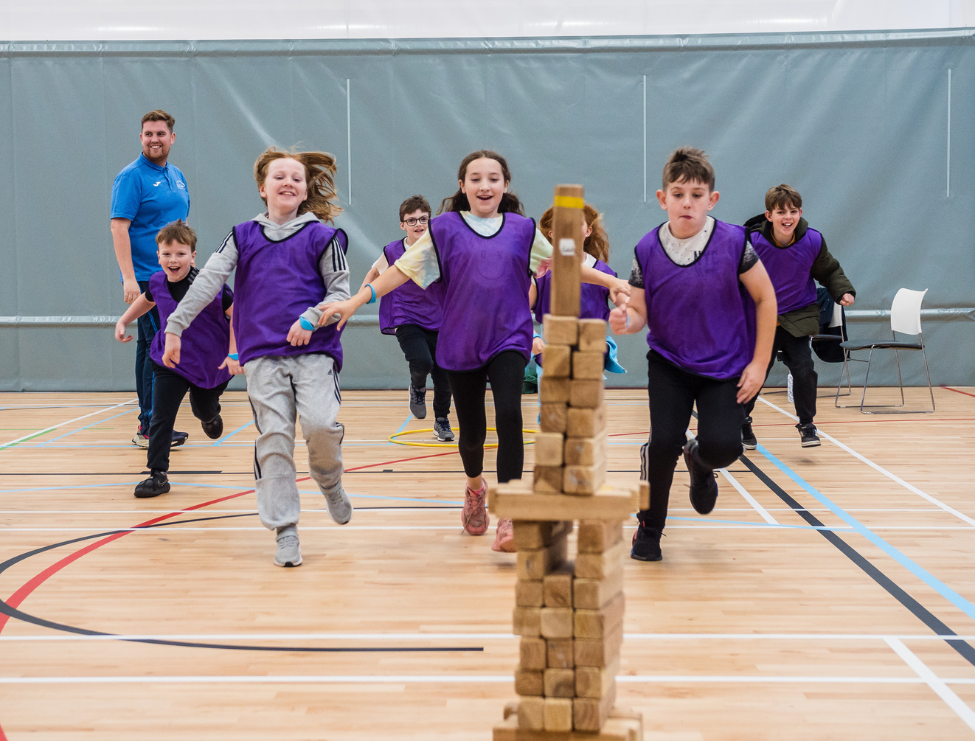
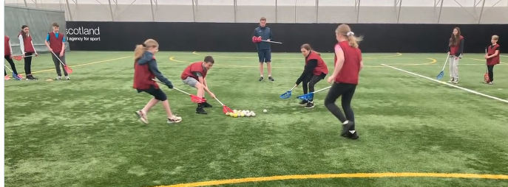
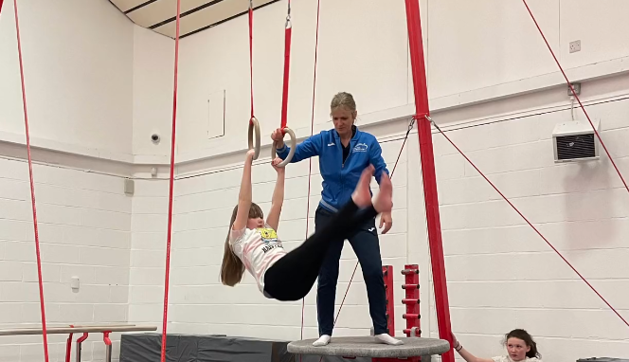
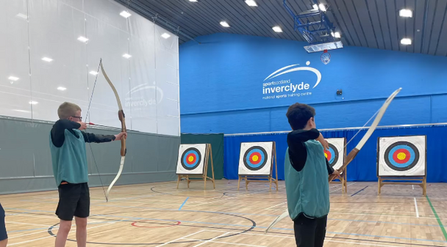
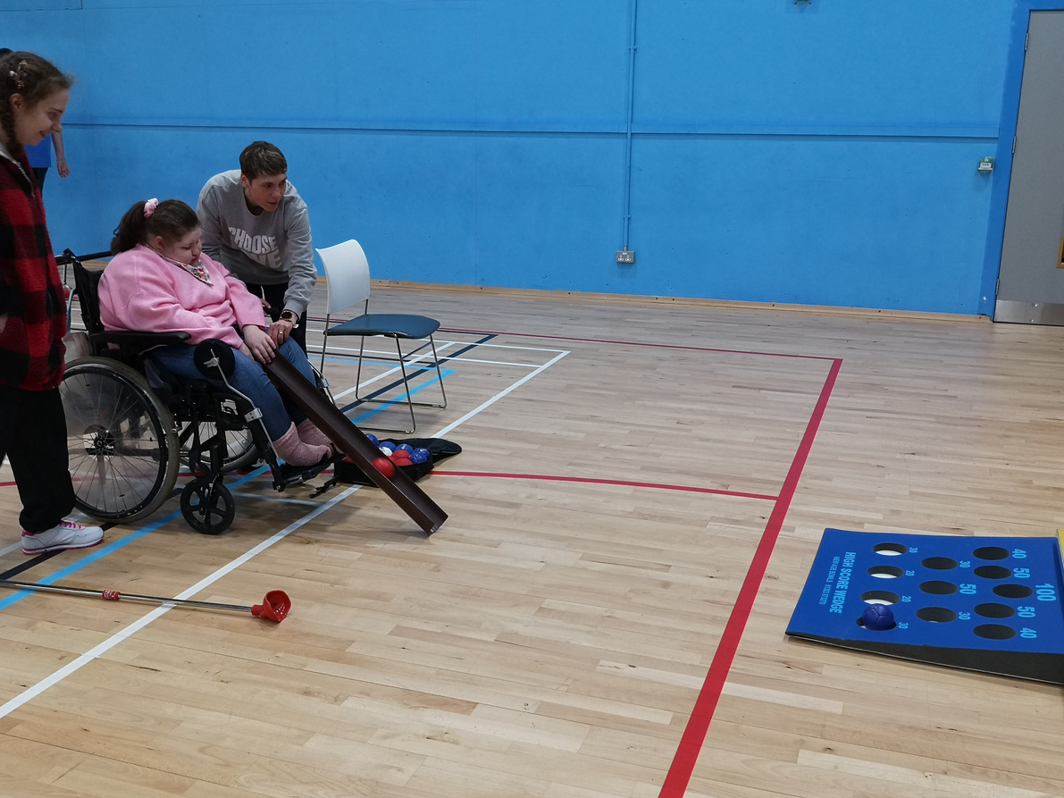
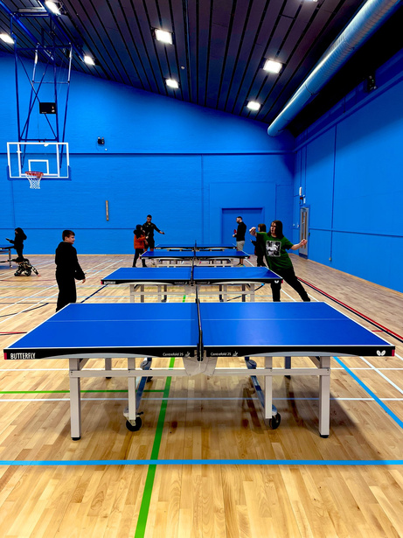
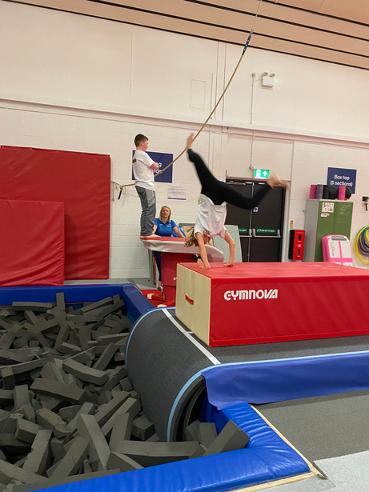
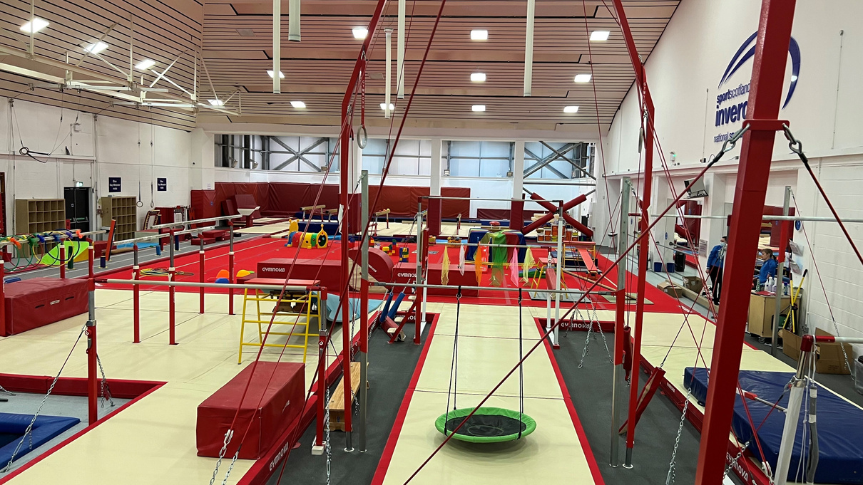
Indoor activities

Slide 6
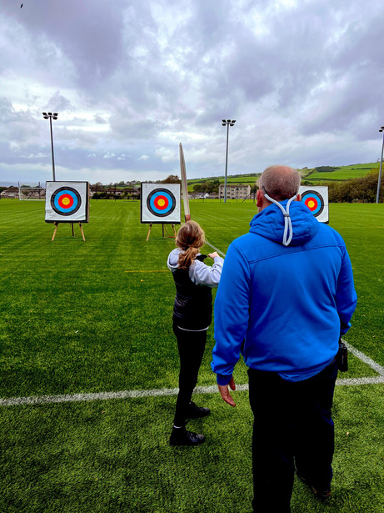
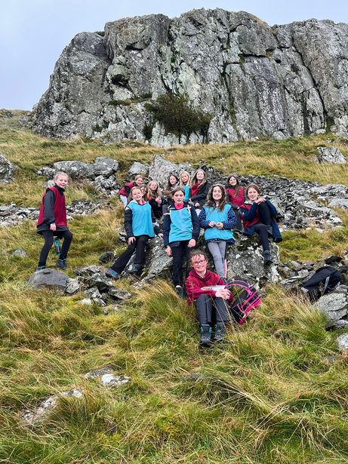
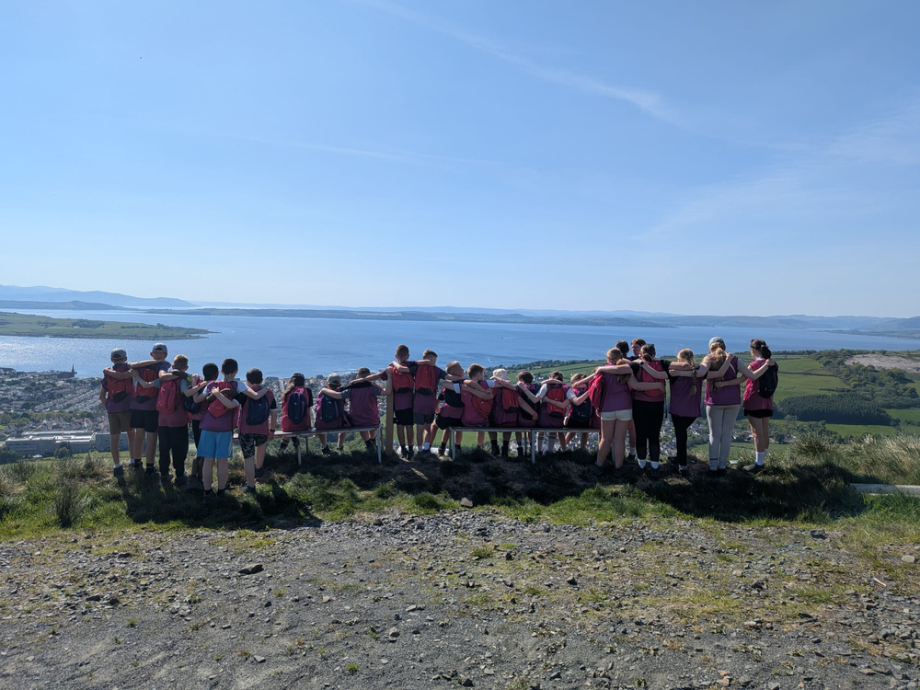
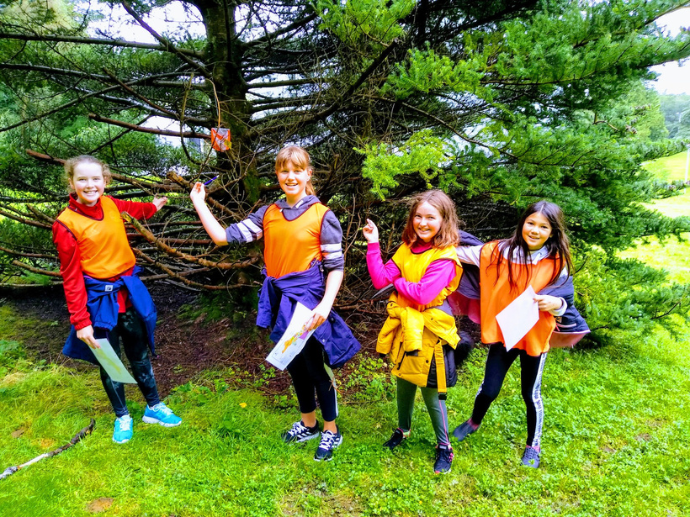
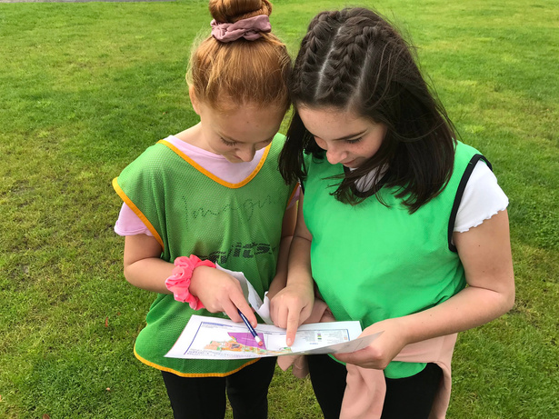
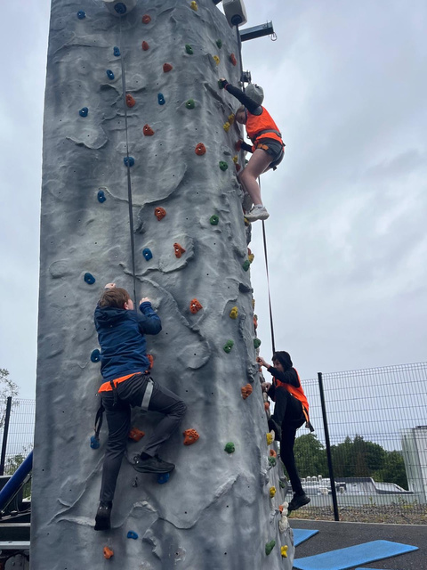
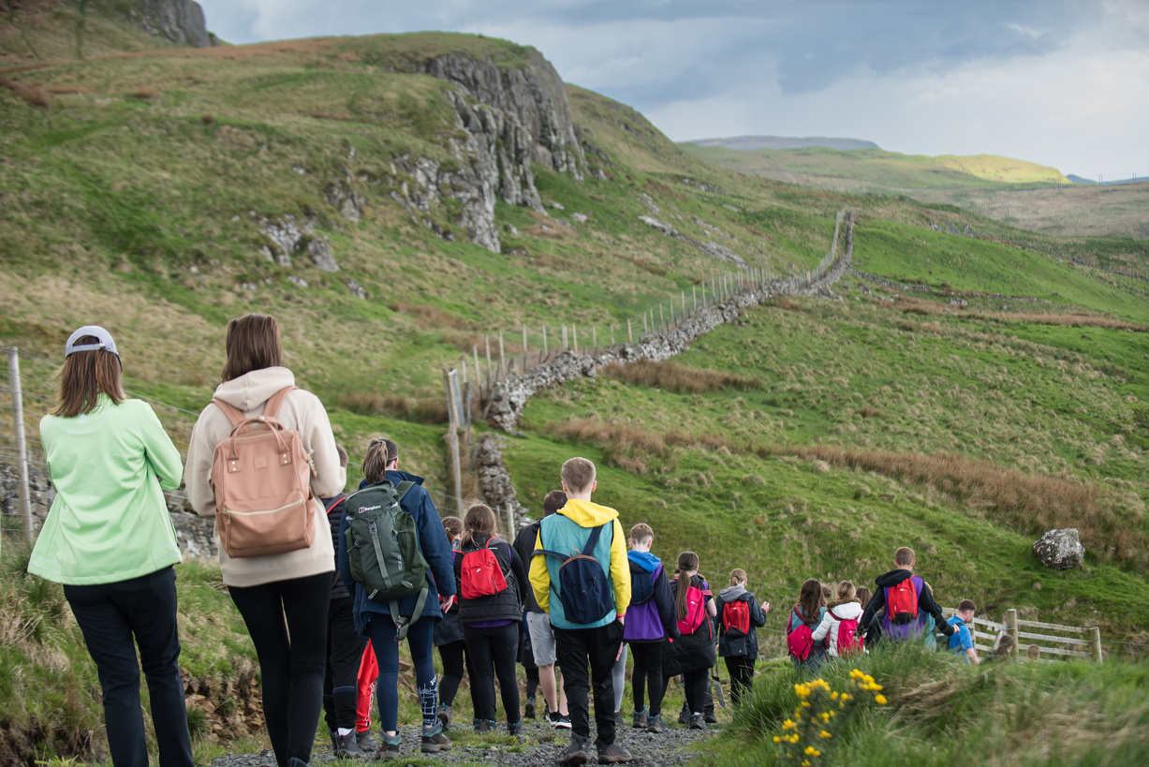
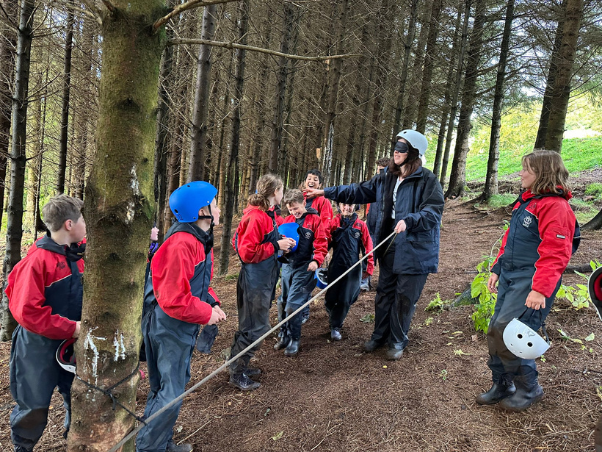
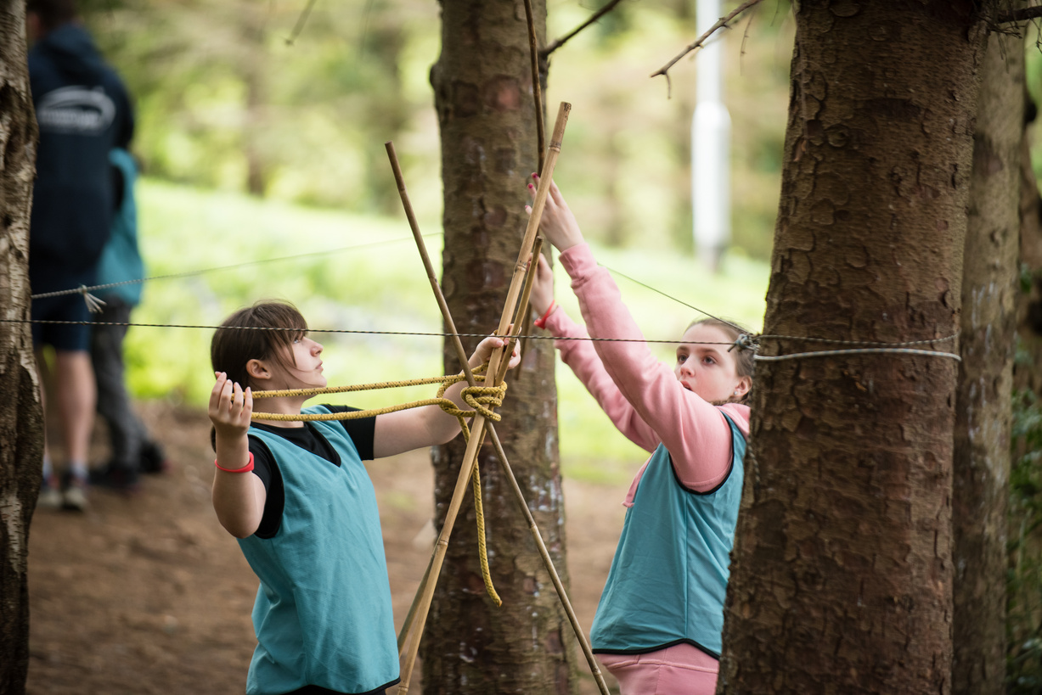
Outdoor activities

Slide 7
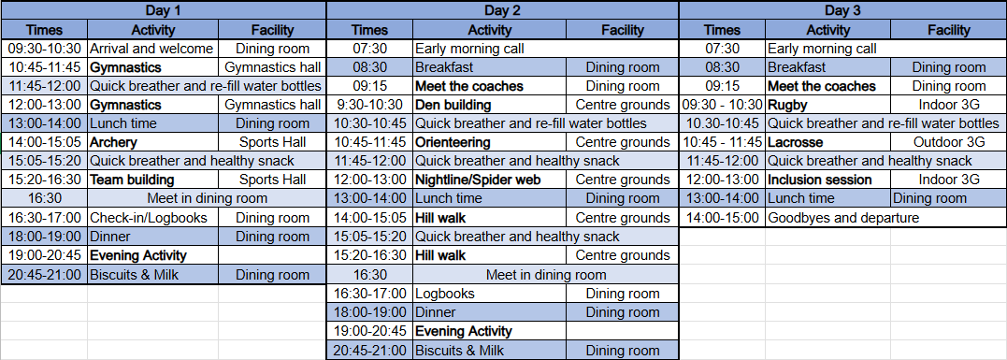
A sample programme

Slide 8
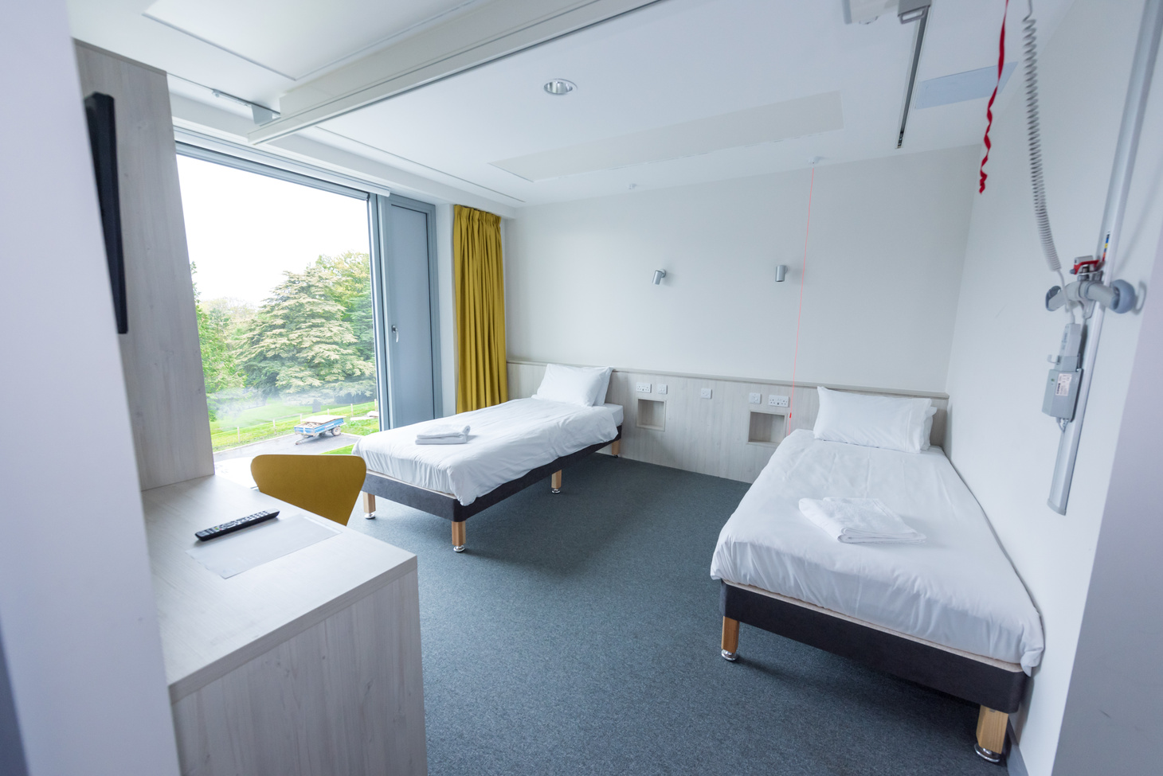
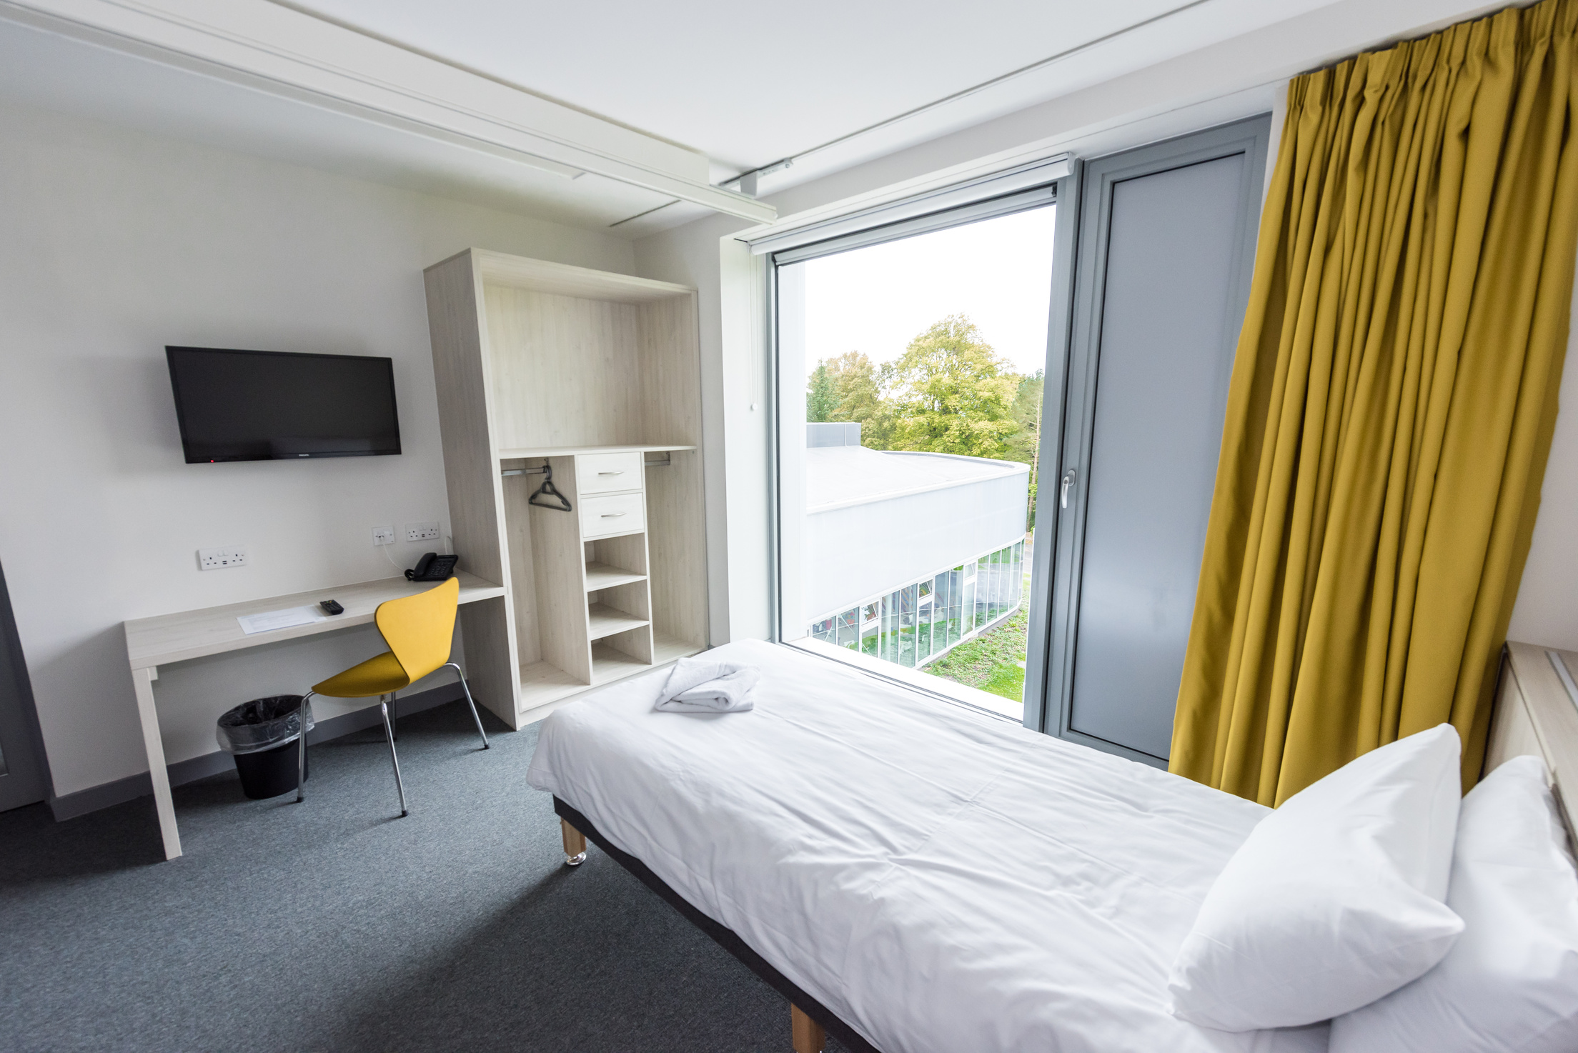
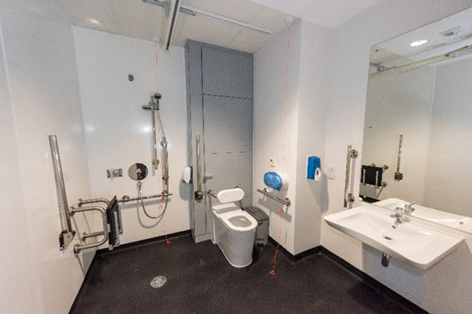
Accommodation

Slide 9
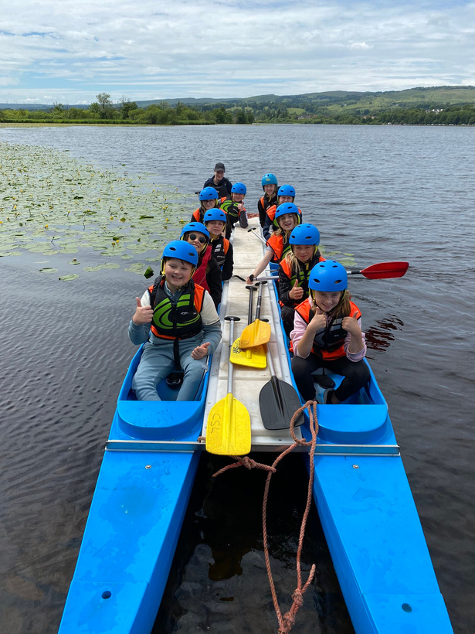
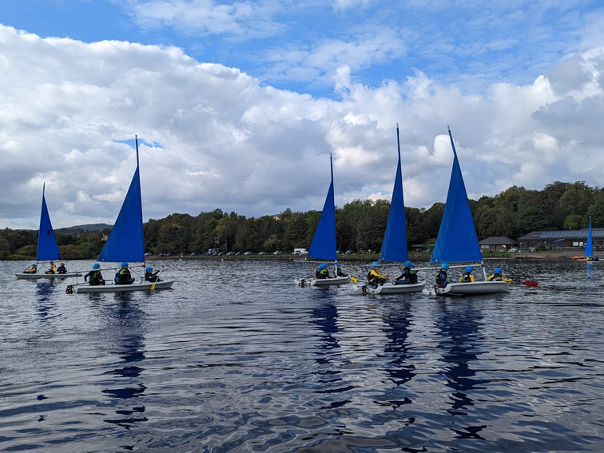
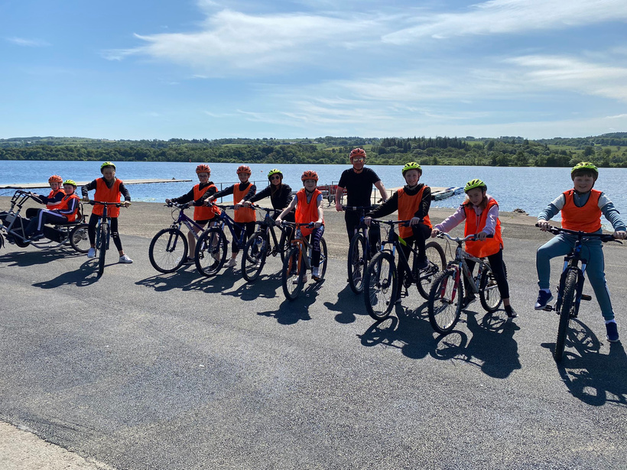
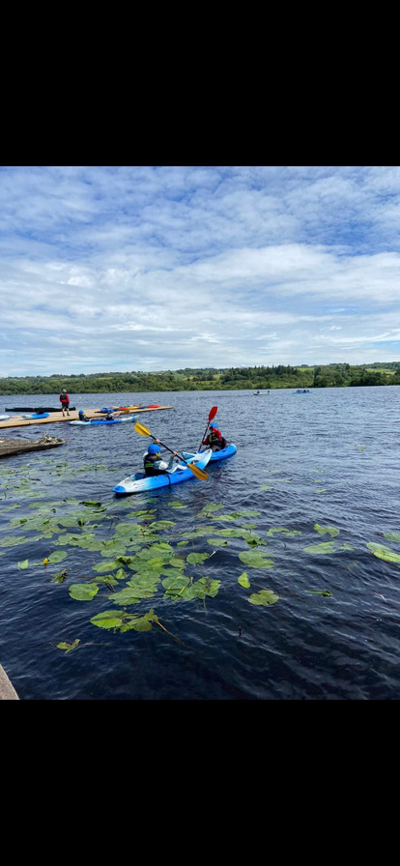
Watersports at Castle Semple
  School groups can choose to add on watersports and cycling trips utilising local providers.
  Watersports available include: ?Sailing, kayaking, windsurfing and paddleboarding

Slide 10
Catering
Healthy food is an essential part of our residential sports experience.
We provide;
  High quality, well balanced and nutritious meals and snacks
  All food is freshly prepared on site
  Tailored meals to suit specialist dietary requirements
  Excellent dining facilities

Slide 11
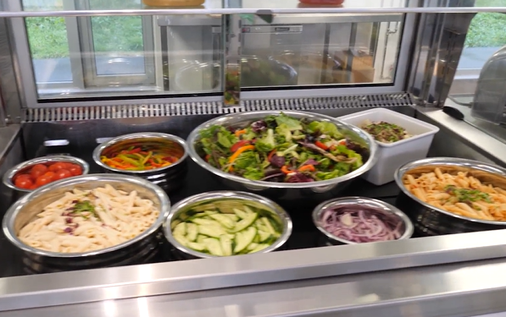
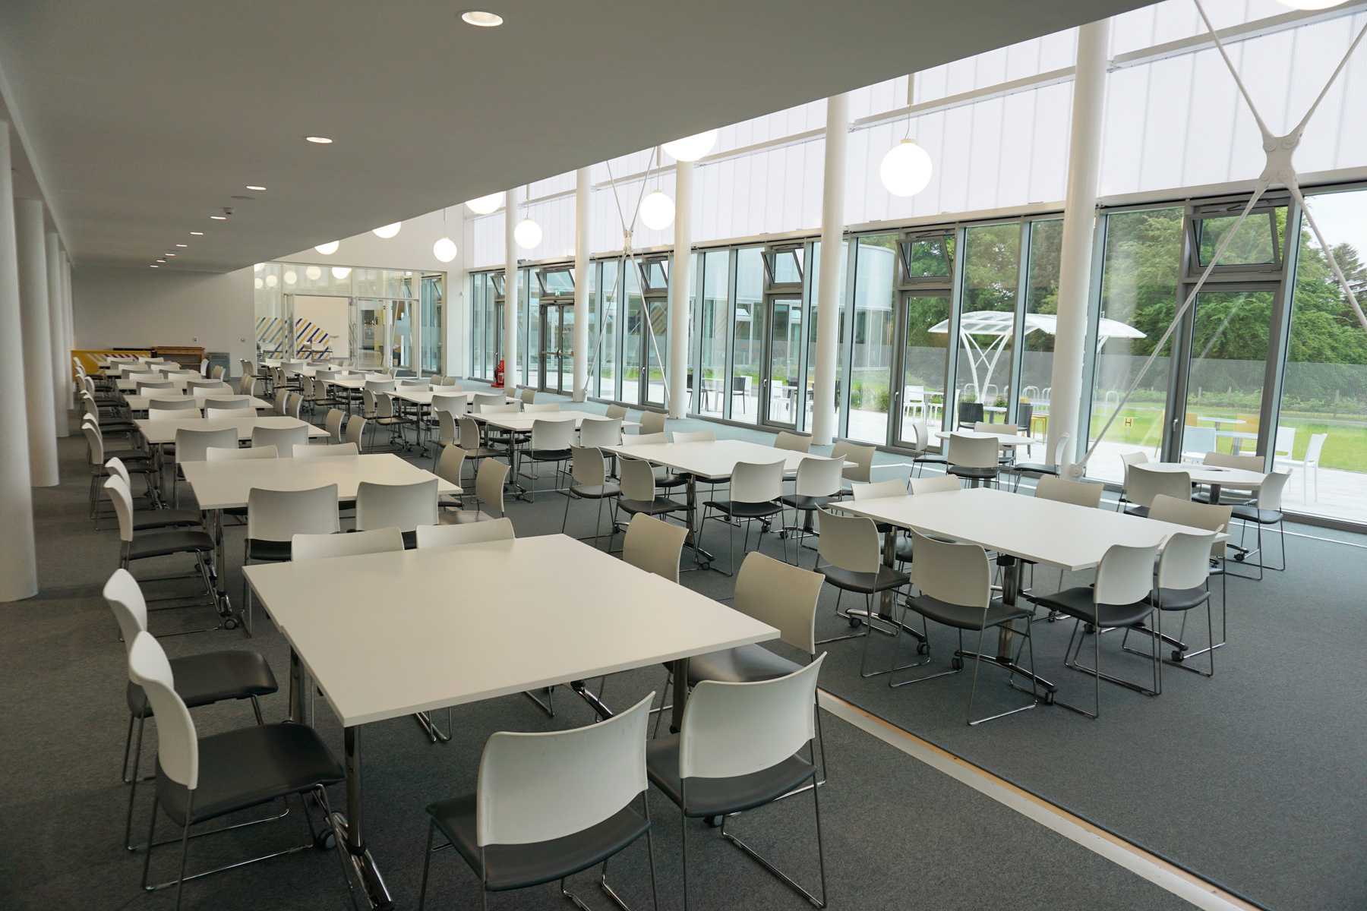
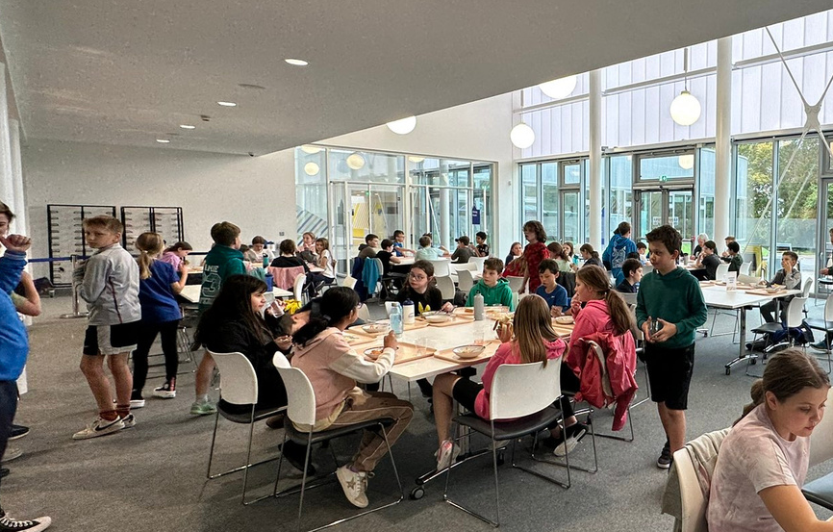
Catering

Slide 12
Safe and secure
Our accommodation block is fully inclusive and every room can accommodate 2 wheelchair users.
We also have secure access to the rooms
  Secure access lifts
  Rooms are key card controlled
  Night concierge – 24 hour supervision
Further safety measures:
  CCTV in communal areas
  Movement activated lights
Pupils must wear bibs at all times

Slide 13
What to bring
We have a dedicated webpage to information for parents and guardians - please visit www.nationalcentreinverclyde.org.uk/schools
Your child should arrive, dressed ready for participation in sport and physical activities and wear comfortable trainers.
We encourage young people to come prepared for the week with:
Clothing
Shorts & t-shirts (enough for the duration of their stay)
Joggers and warm jumpers
Hats, scarves and gloves (weather dependant)
Change of clothes for evening activities
Waterproof jacket
Training shoes (1 pair minimum)
Outdoor shoes/wellies
Swim wear & towel (if swimming or Watersports is included)
Sleep wear
Underwear & socks
Toiletries
Tooth brush & toothpaste
Shower Gel & shampoo
General toiletries
Other Items:
Backpack
Water bottle
Sun hat/cap
Sun tan lotion
Any medication (i.e. inhalers etc.)
Money - the school can advise on their policy for this - all food etc is included in the stay. Café and vending machines available. Please note we cannot provide change so please bring loose coins if school allows.
Your child’s school will have their own procedures regarding bringing mobile phones, tablets, DS’s or any other electrical equipment. However, it would be advisable to leave these at home due to safeguarding and liability reasons. sportscotland do not accept liability for the loss or damage of any belongings and advise parents to be mindful if allowing children to bring any items of value.

Slide 14
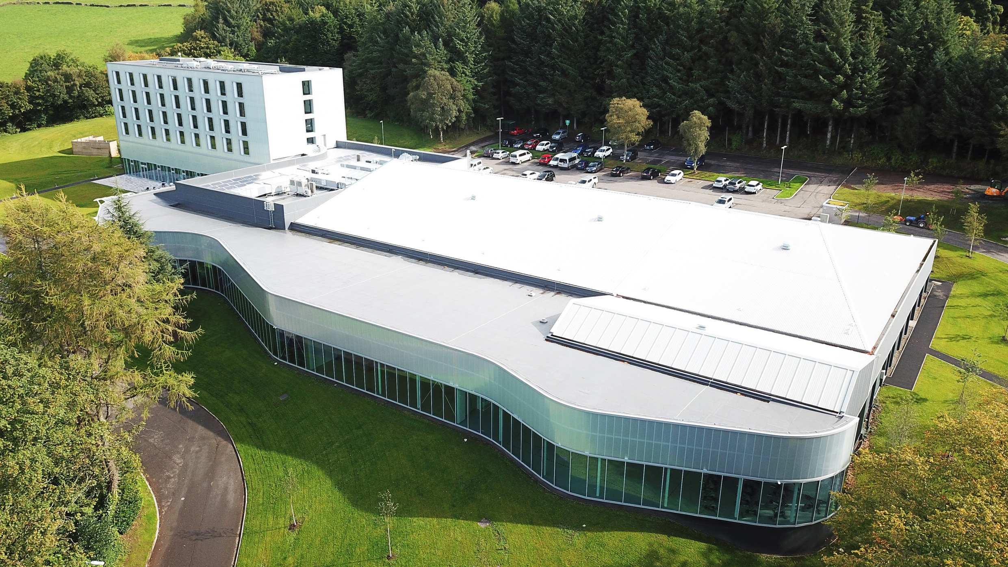
Thank you! Any questions?
Please remember we have lots of information on our dedicated webpage - visit nationalcentreinverclyde.org.uk/schools

